Slide 1
Sulawesi Stress Inversion

Slide 2
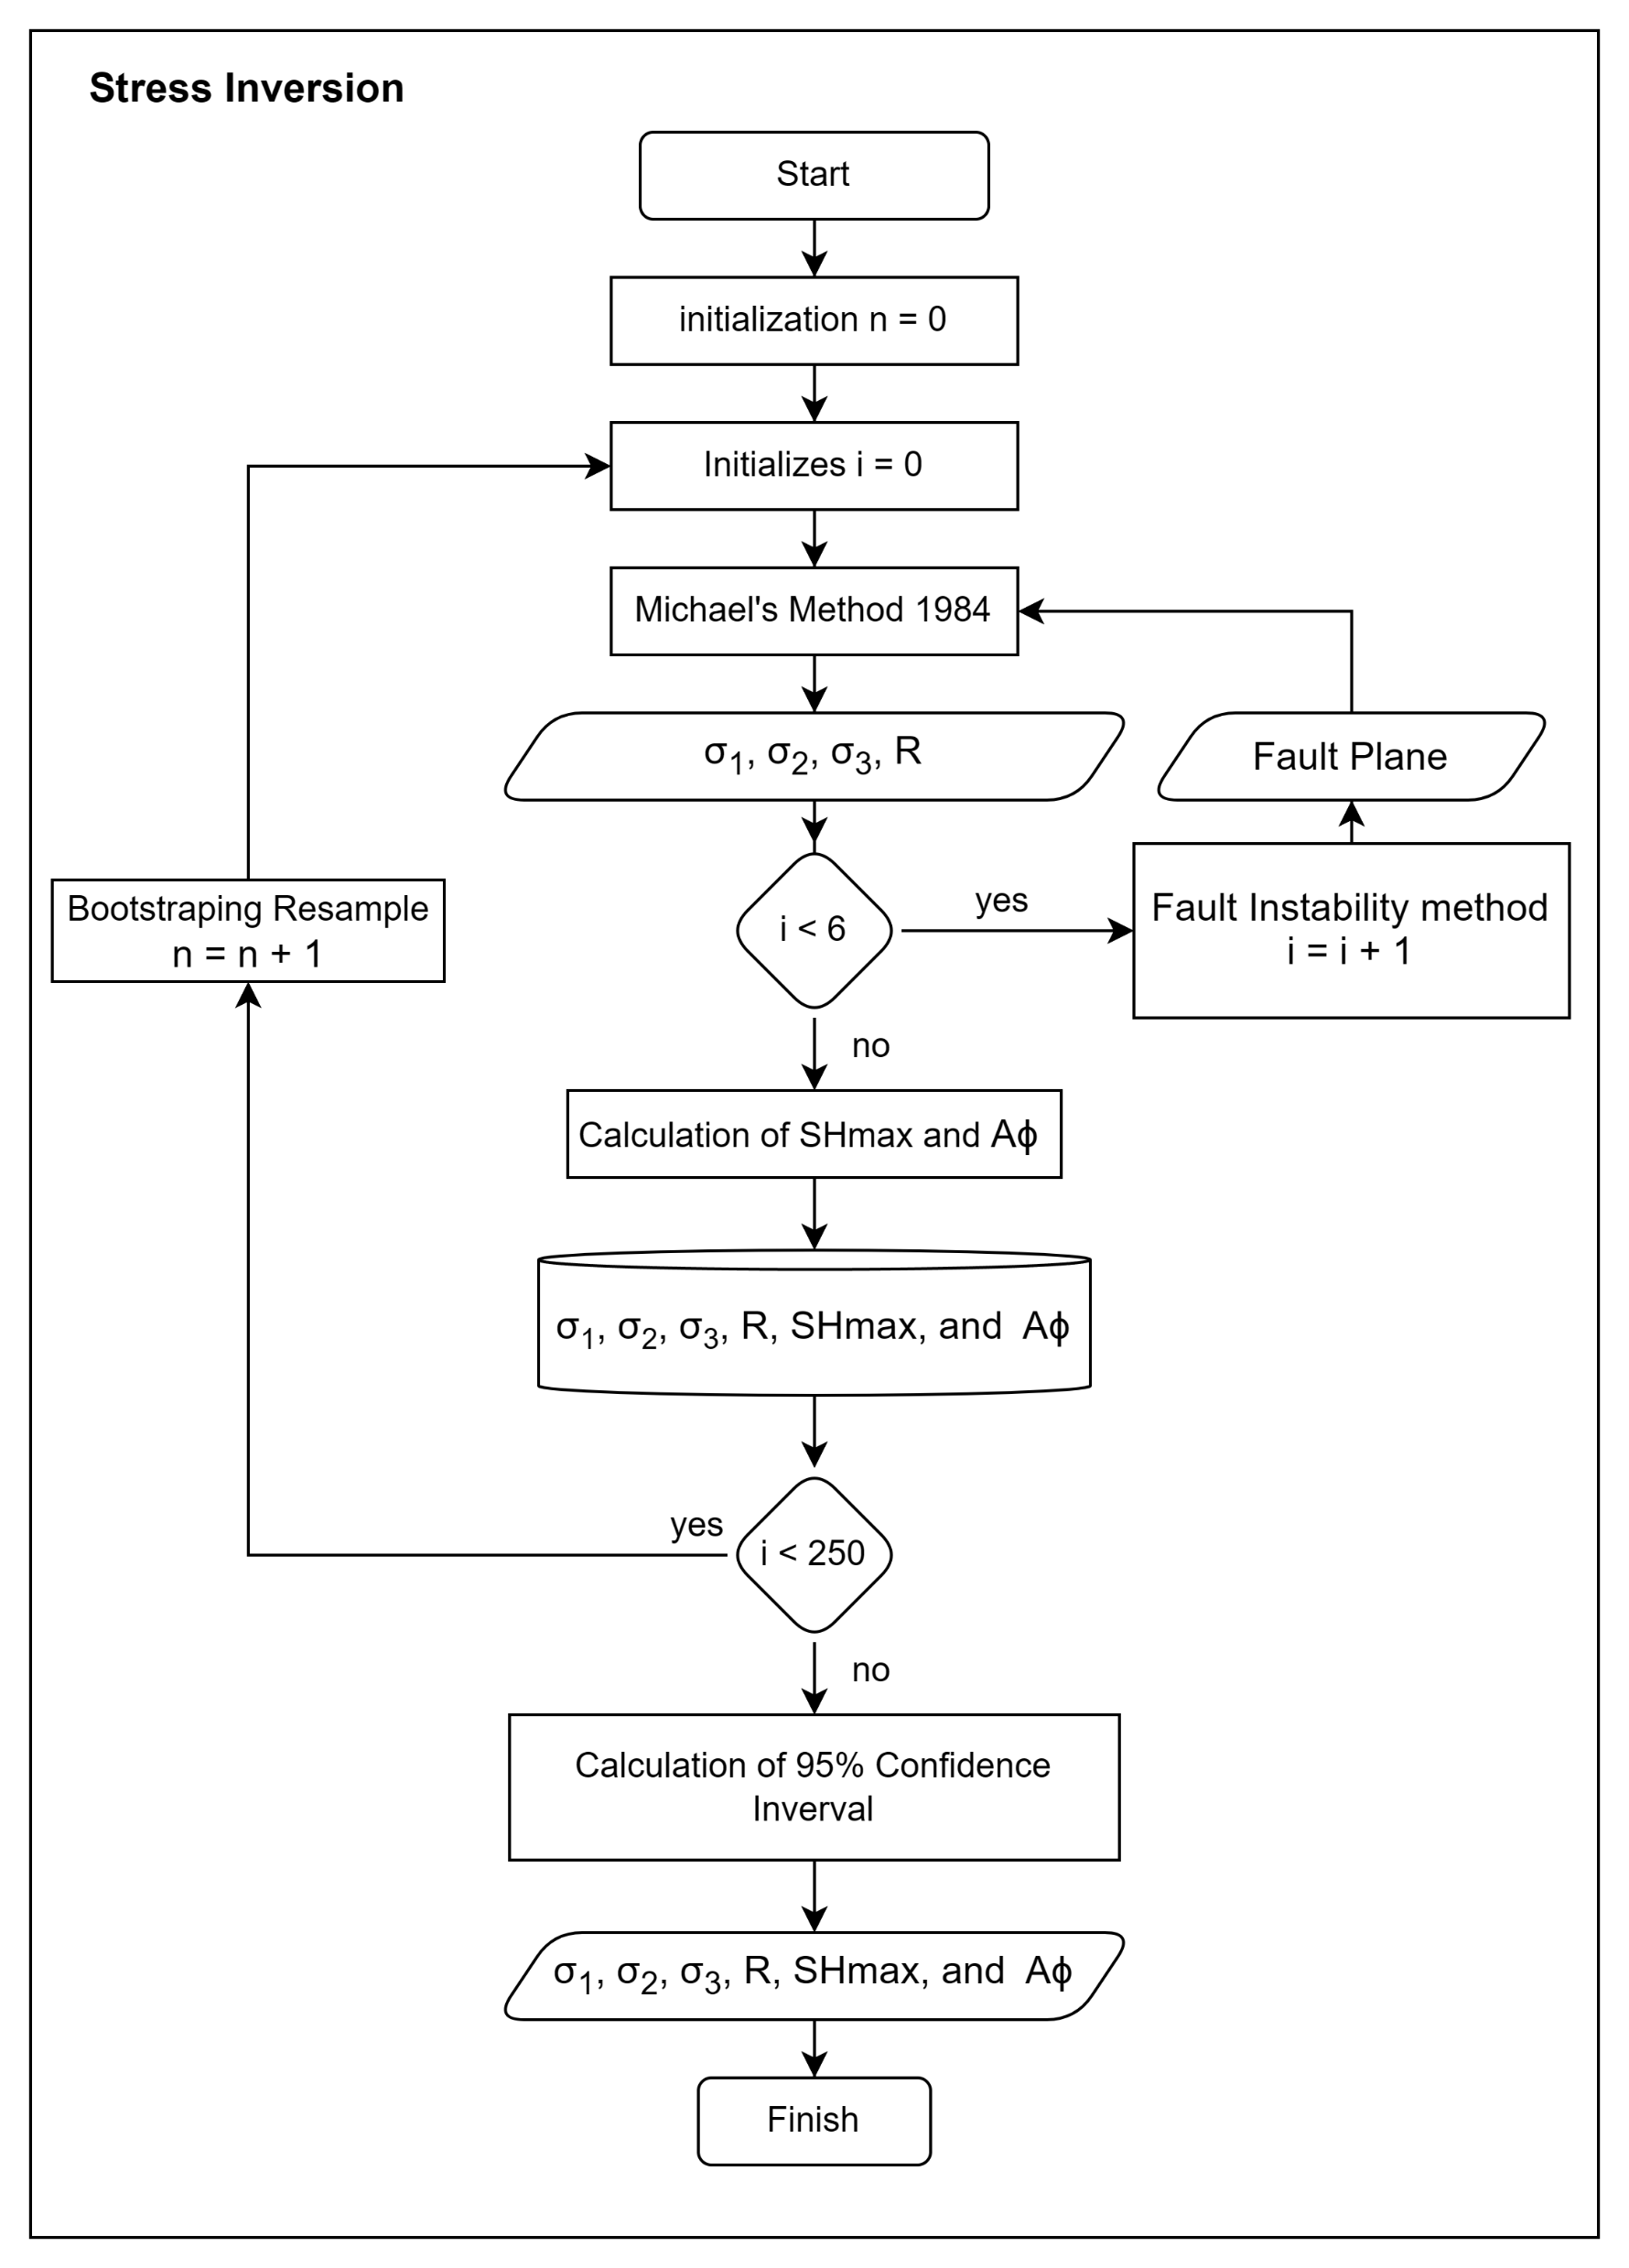
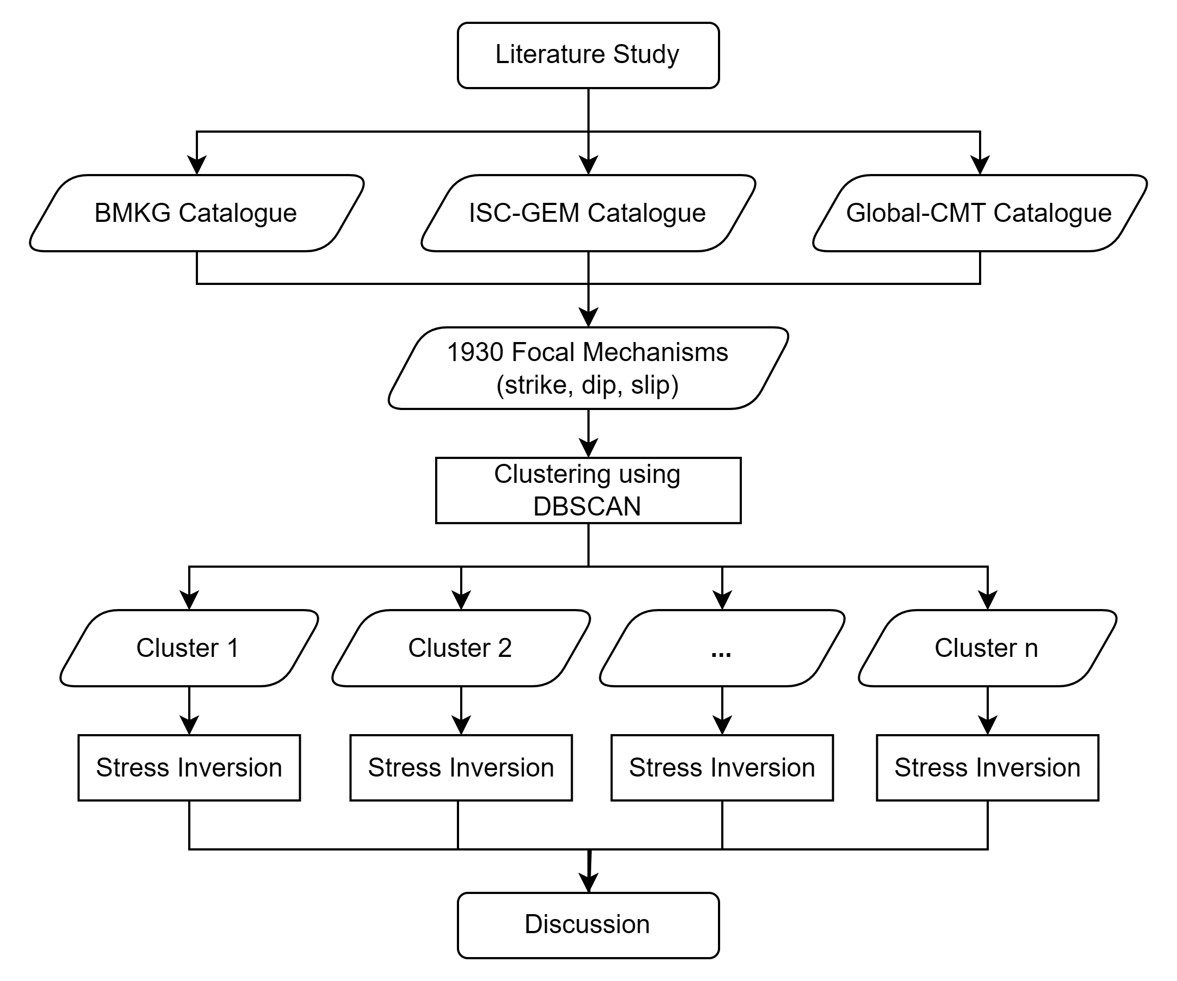
Methods
The stress inversion process was conducted using a modified version of the STRESSINVERSE algorithm by Vavryčuk, 2014, incorporating SHmax and Simpson's Index calculations.
Measurement uncertainty was estimated using the bootstrap resampling method with 250 samples.

Slide 3
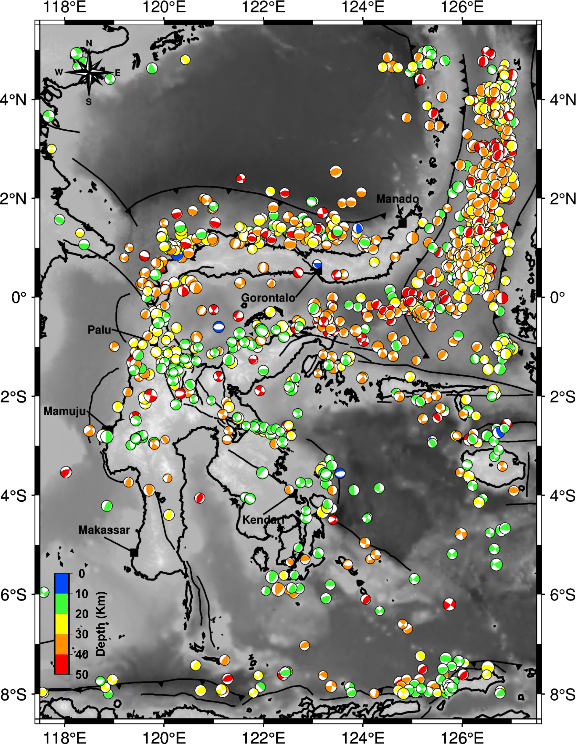
Focal Mechanism Data
A map showing the distribution of 1390 focal mechanism data with 4.0 < Mw < 7.0 and depth ≤ 50 km from April 1967 to September 2022. The surface fault traces around Sulawesi Island were obtained from Pusgen (2017). The red box highlights the major city with a highly dense population.

Slide 4
Clustering Result
We performed clustering using the Unsupervised Machine Learning approach with the Density-Based Spatial Clustering of Applications with Noise (DBSCAN) algorithm. The Minimum Points (MinPts) parameter was tested with values of 10, 15, and 20, each paired with ε = 0 to 0.5 in increments of 0.05
We analyze the distribution of the P-T axes within each of the identified clusters as a reference for validating the clustering results.
As a result, we identified three optimal parameter pairs for clustering our focal mechanism data: MinPts = 15, ε = 0.35, MinPts = 15, ε = 0.40, and MinPts = 15, ε = 0.50.

Slide 5
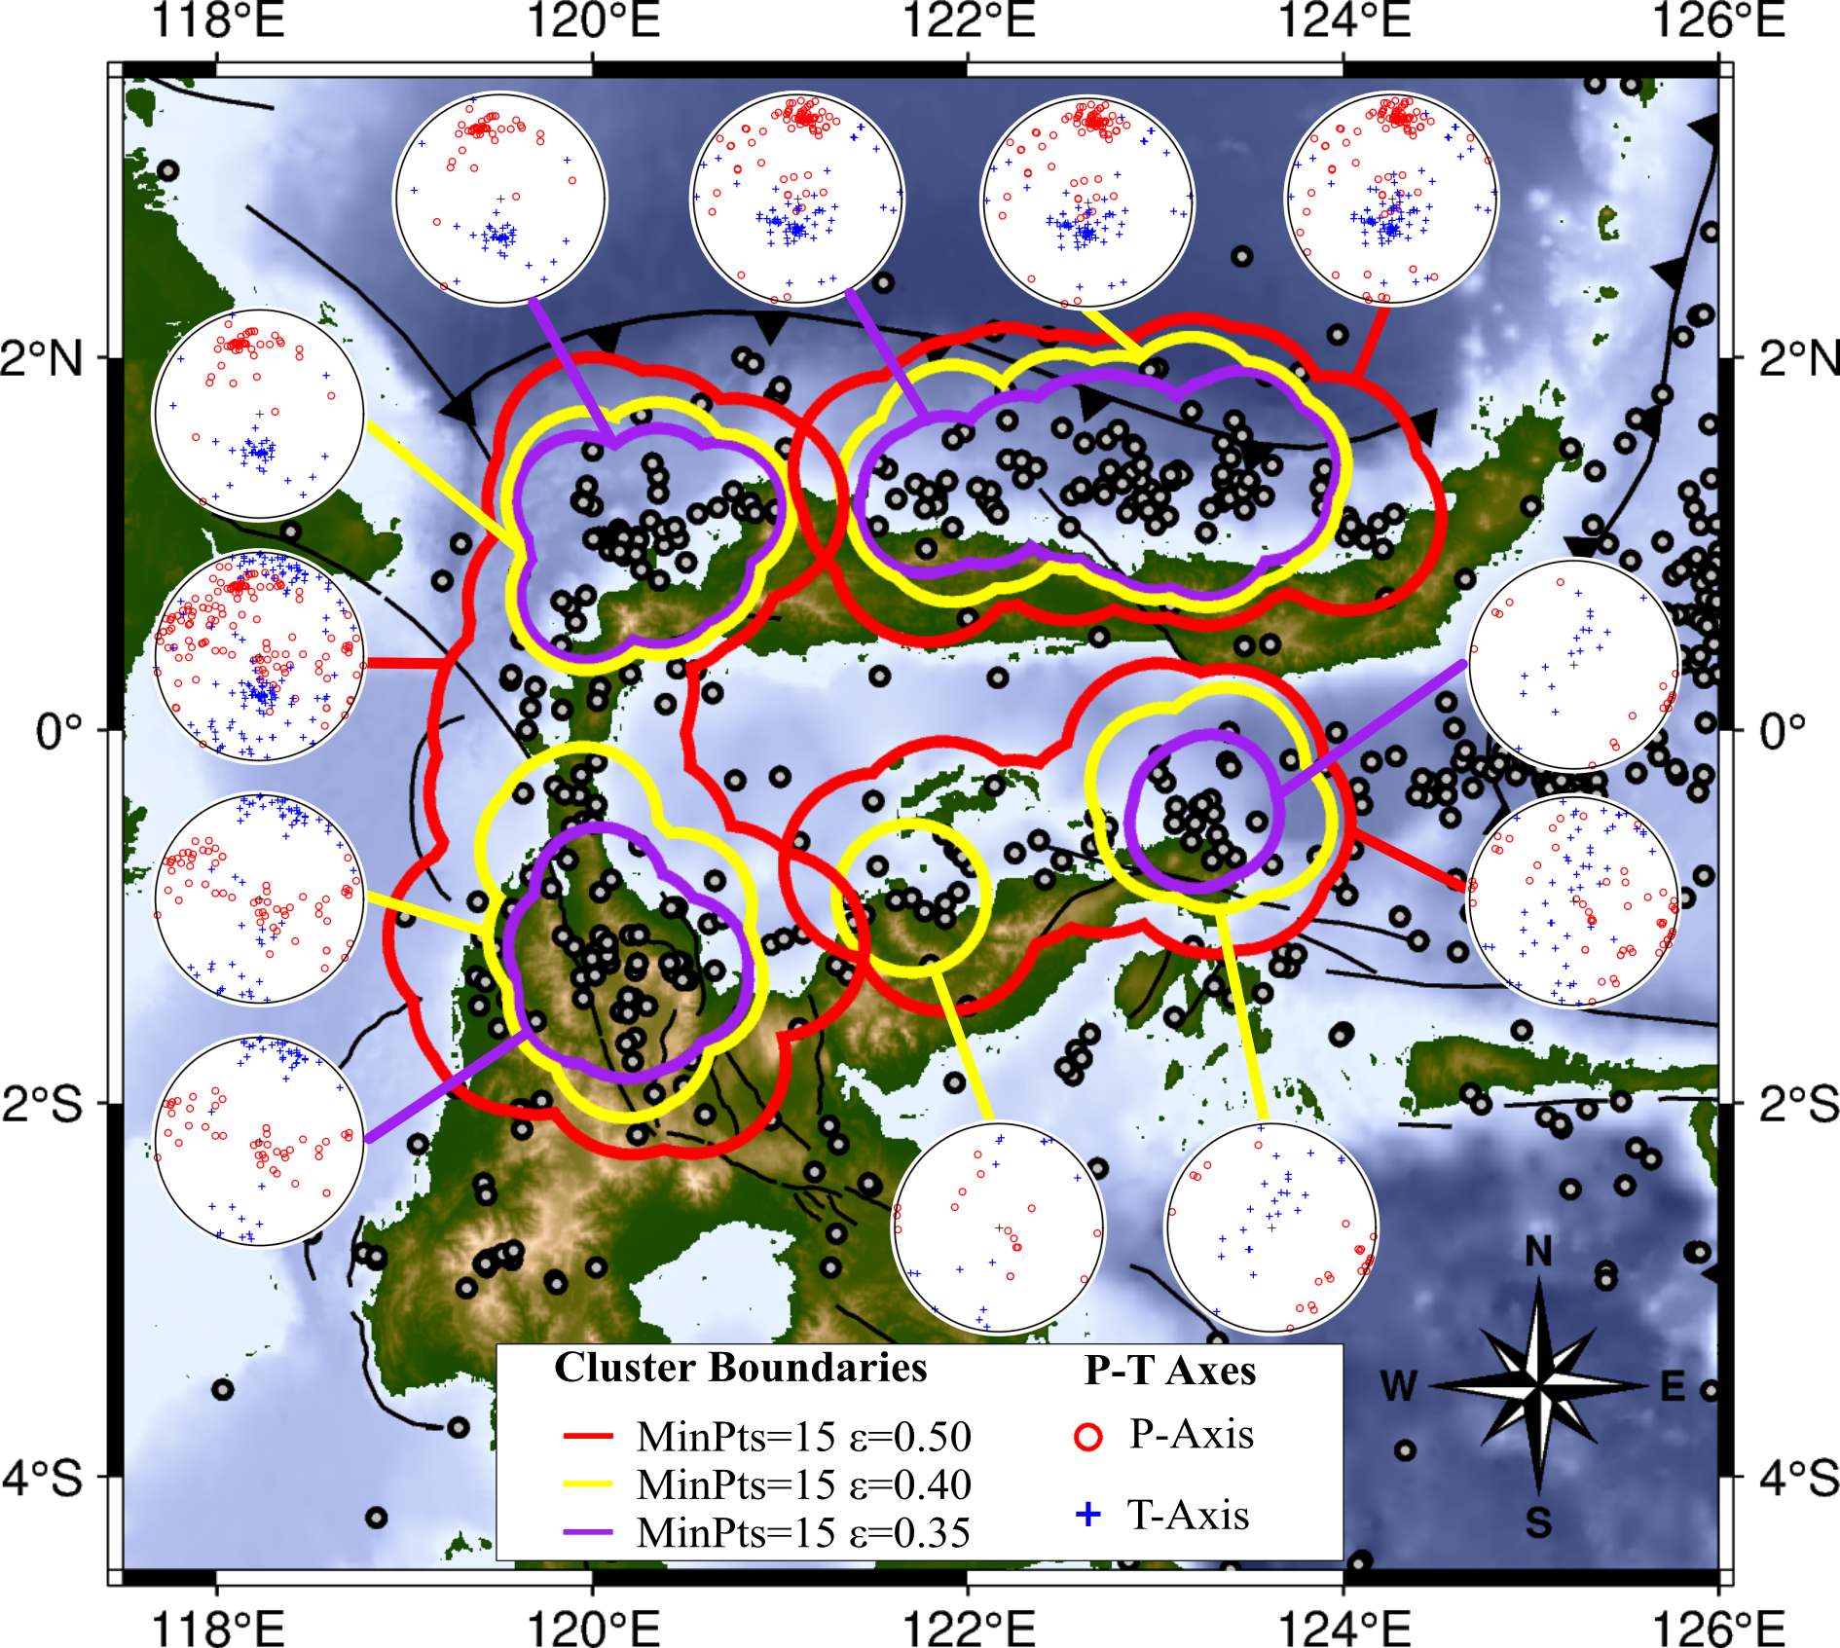
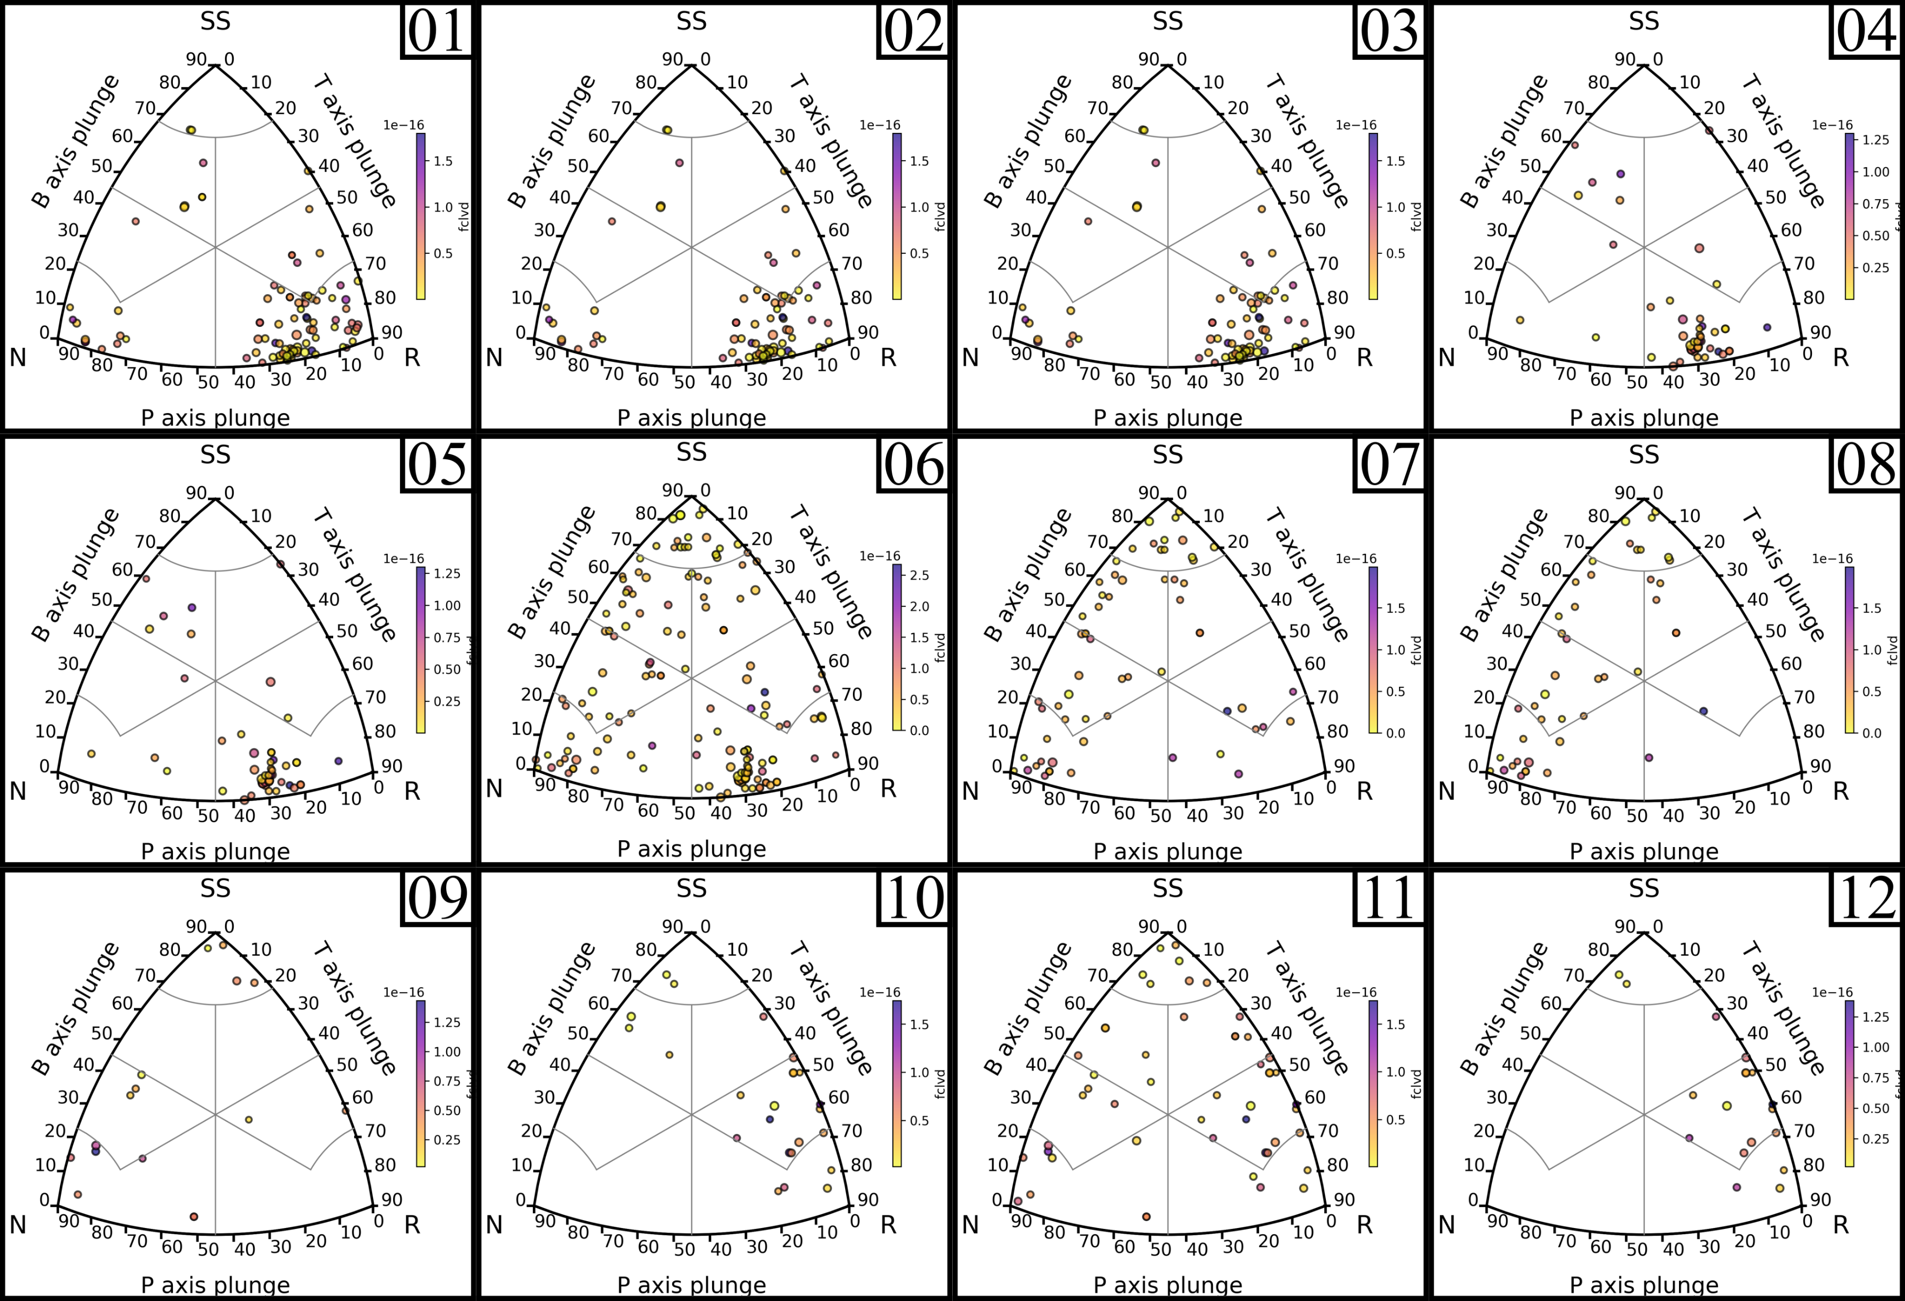
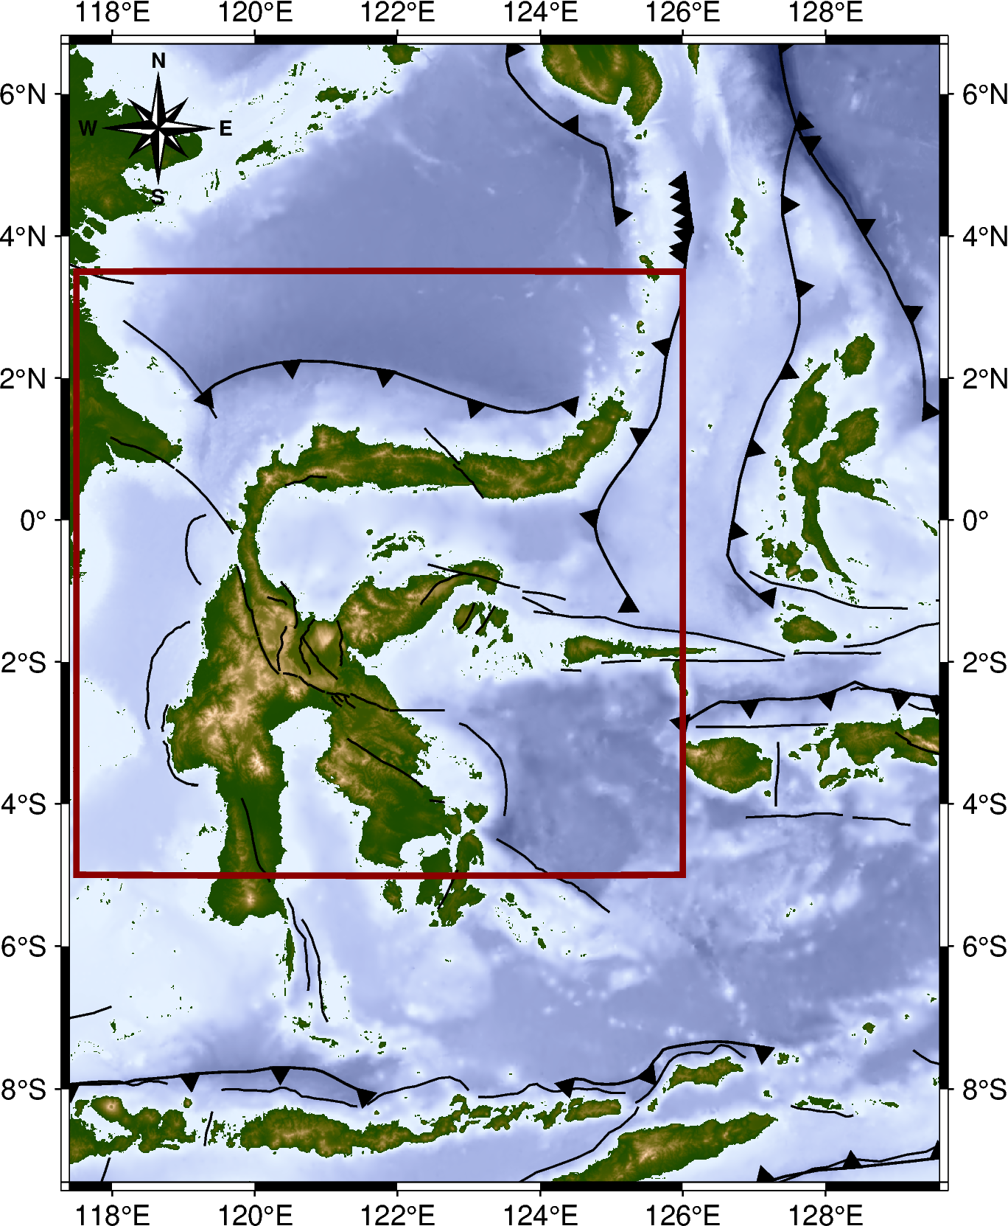
$$Clustering Result$$
Northern Sulawesi
4
3
2
1
5
6
12
7
11
8
9
10
In the northern part of Sulawesi Island, twelve clusters are identified, consisting of three clusters with ε = 0.50, five clusters with ε = 0.40, and four clusters with ε = 0.35. These clusters are distributed across the subduction zone in the northern arm of Sulawesi, the Palu-Koro Fault, and the eastern arm of Sulawesi.

Slide 6
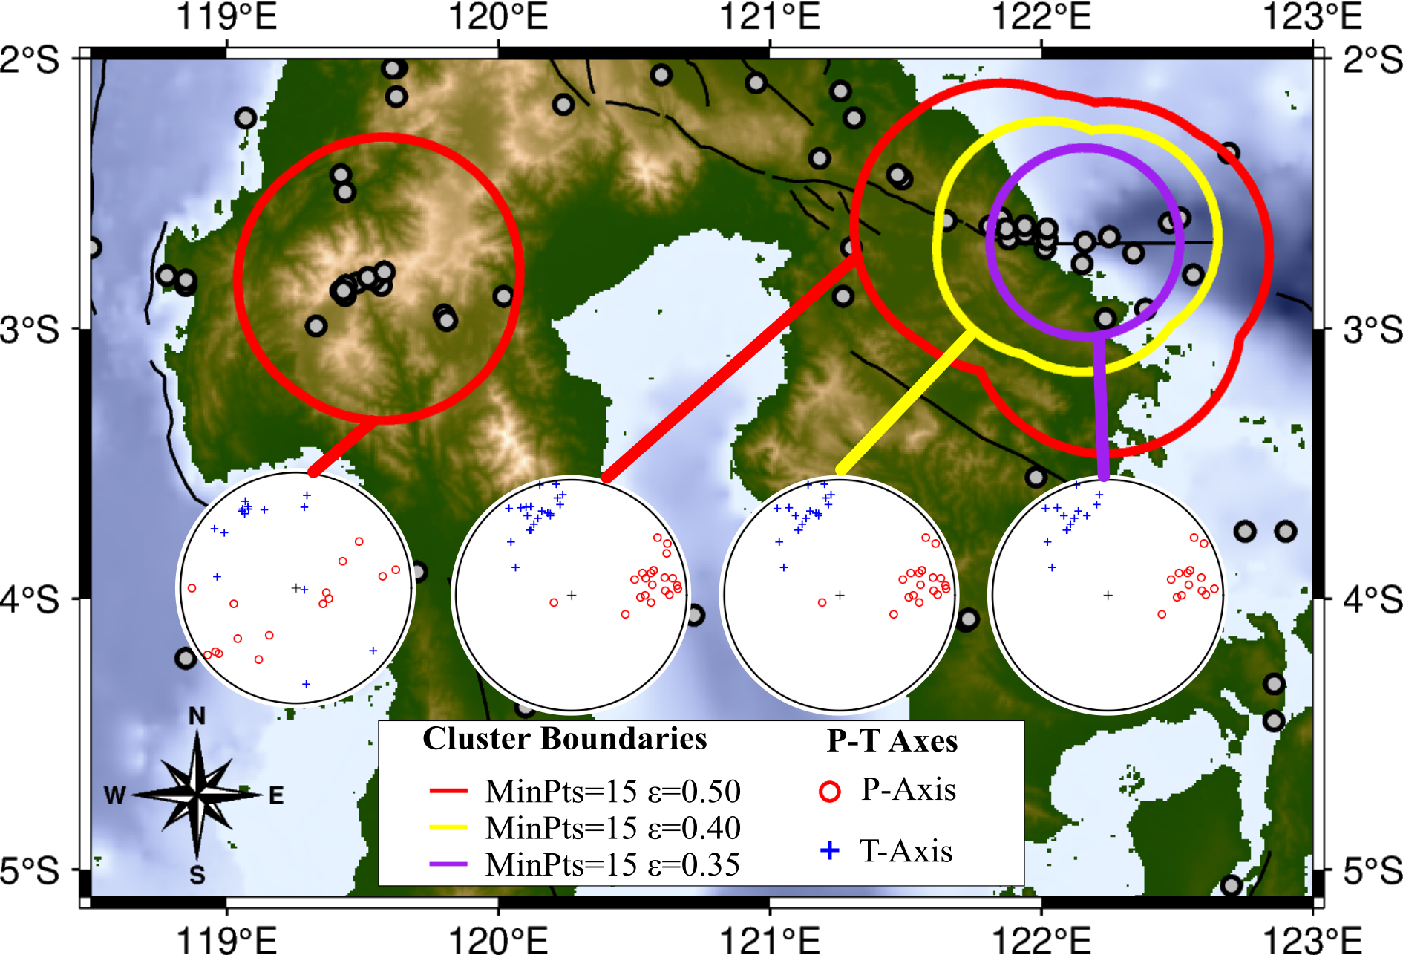
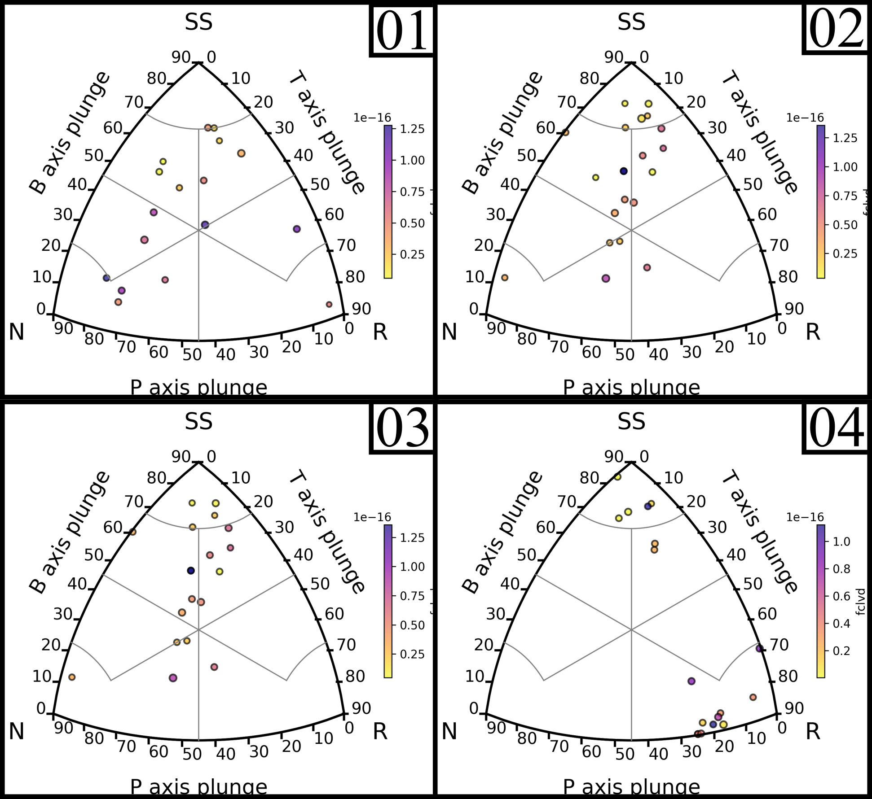
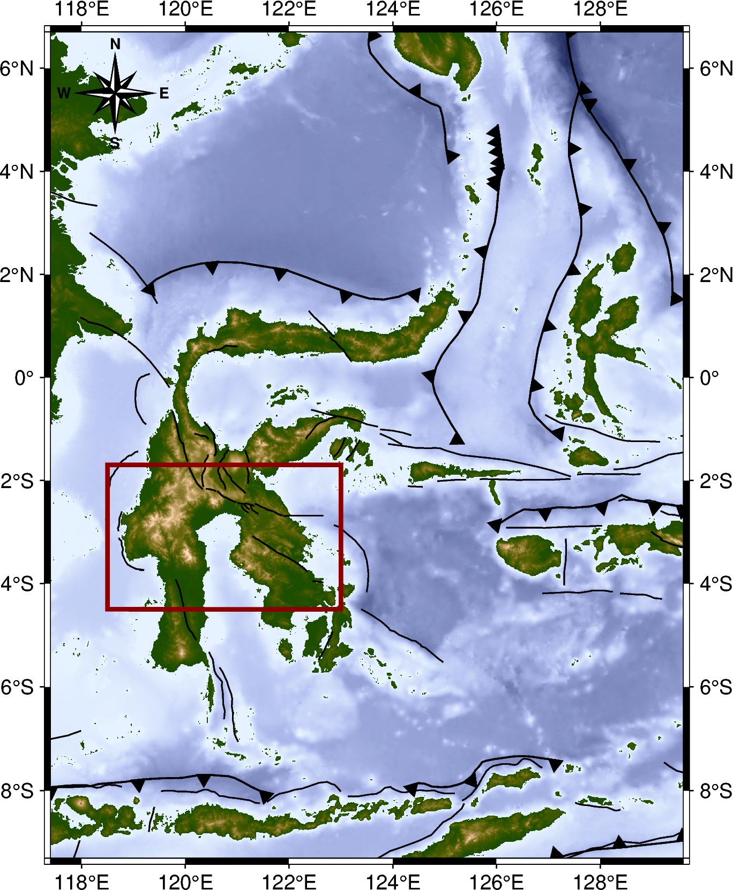
$$Clustering Result$$
Southern Sulawesi
1
2
3
4
In the southern part of Sulawesi Island, four clusters were identified, consisting of two clusters with ε = 0.50, one cluster with ε = 0.40, and one cluster with ε = 0.35. These clusters are located in the Matano Fault area and the Mamasa swarm area.

Slide 7
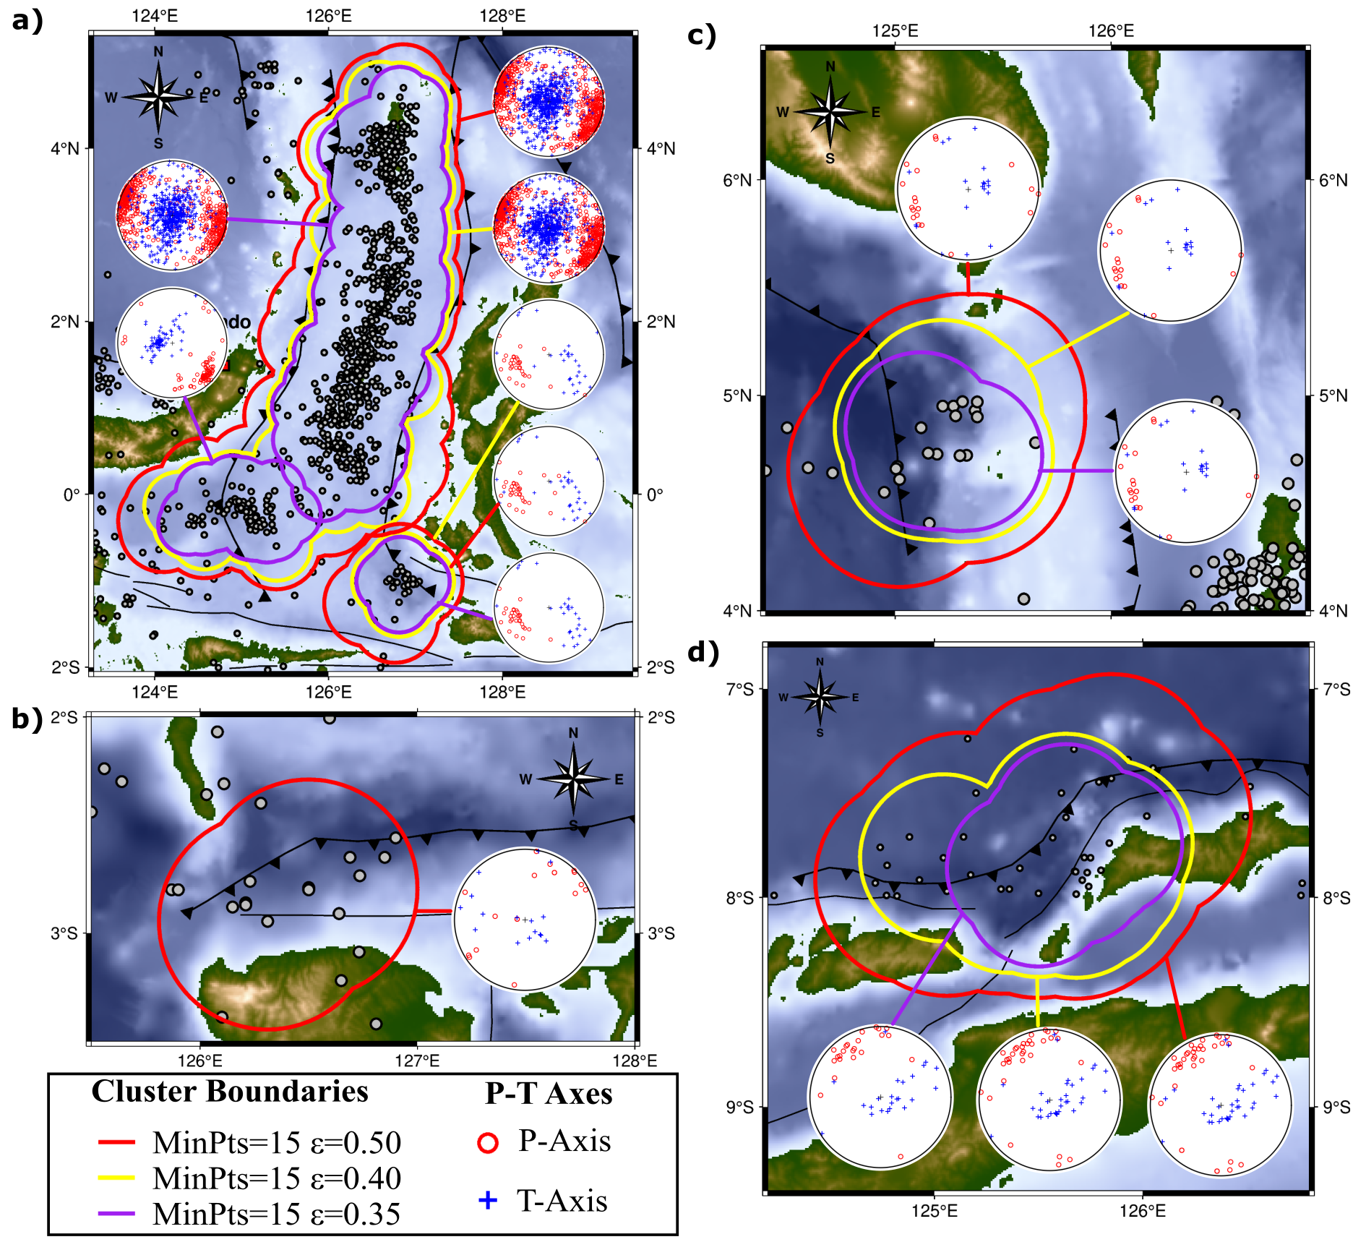
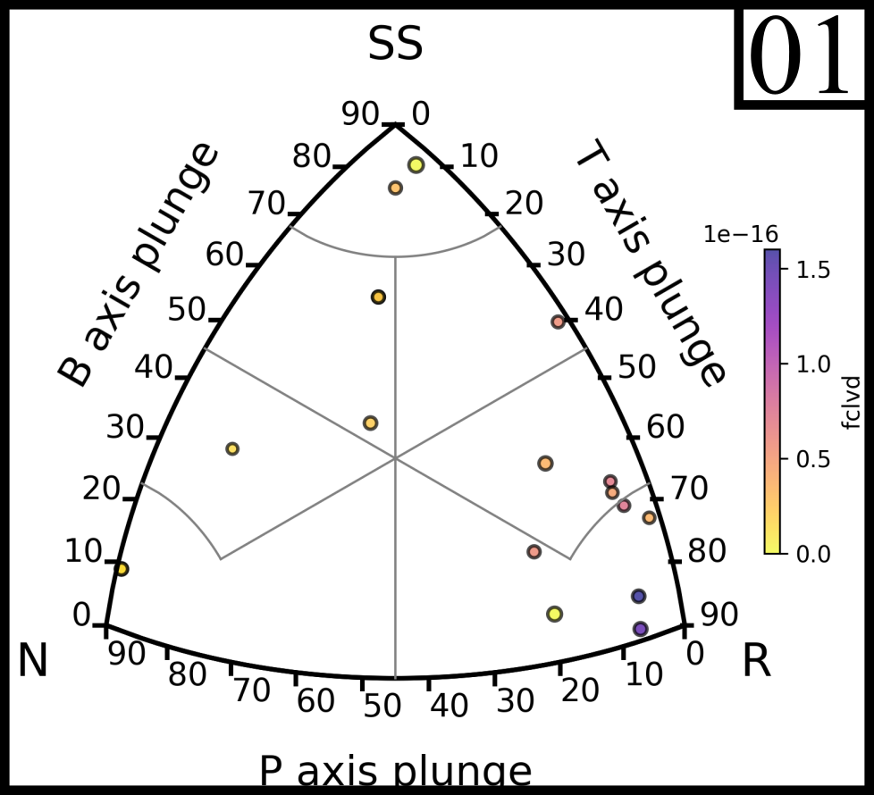
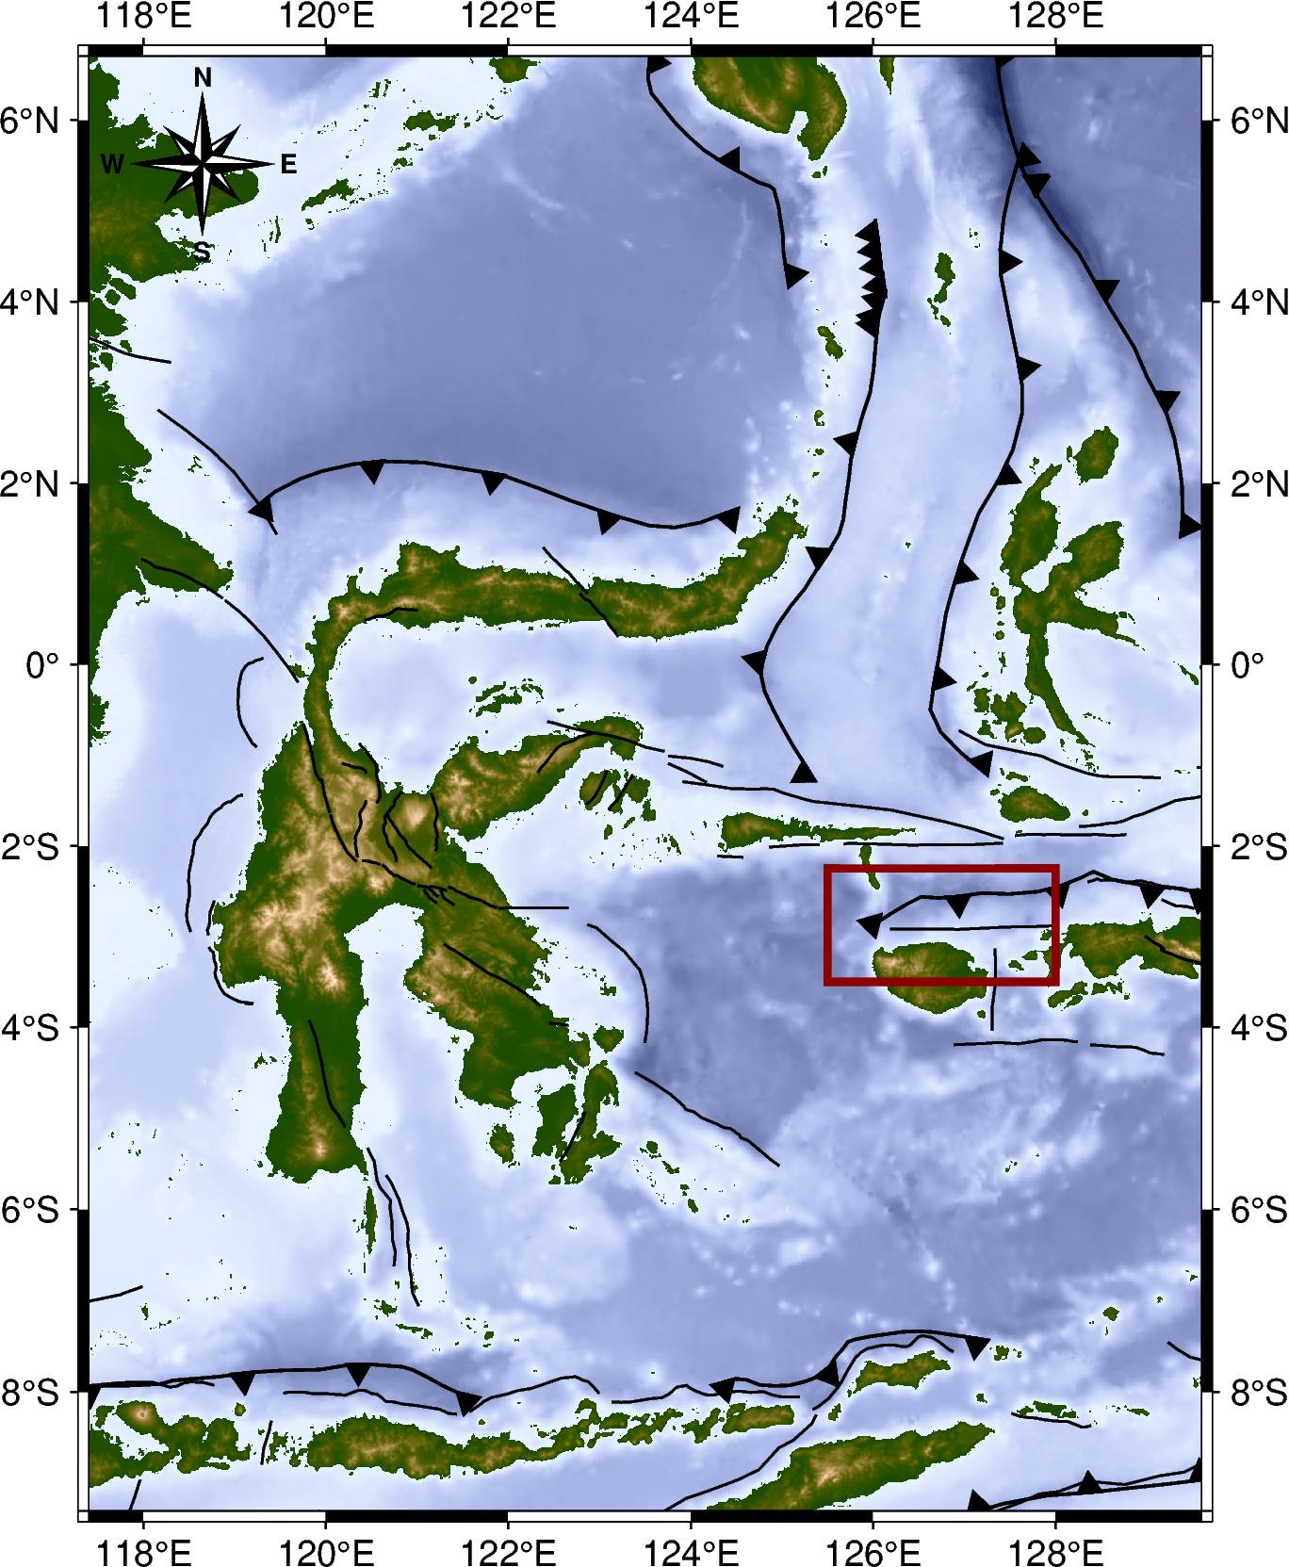
$$Clustering Result$$
Sula Area
In the Sula area, due to the limited data and sparse spatial distribution, only a single cluster was identified with an ε value of 0.50.

Slide 8
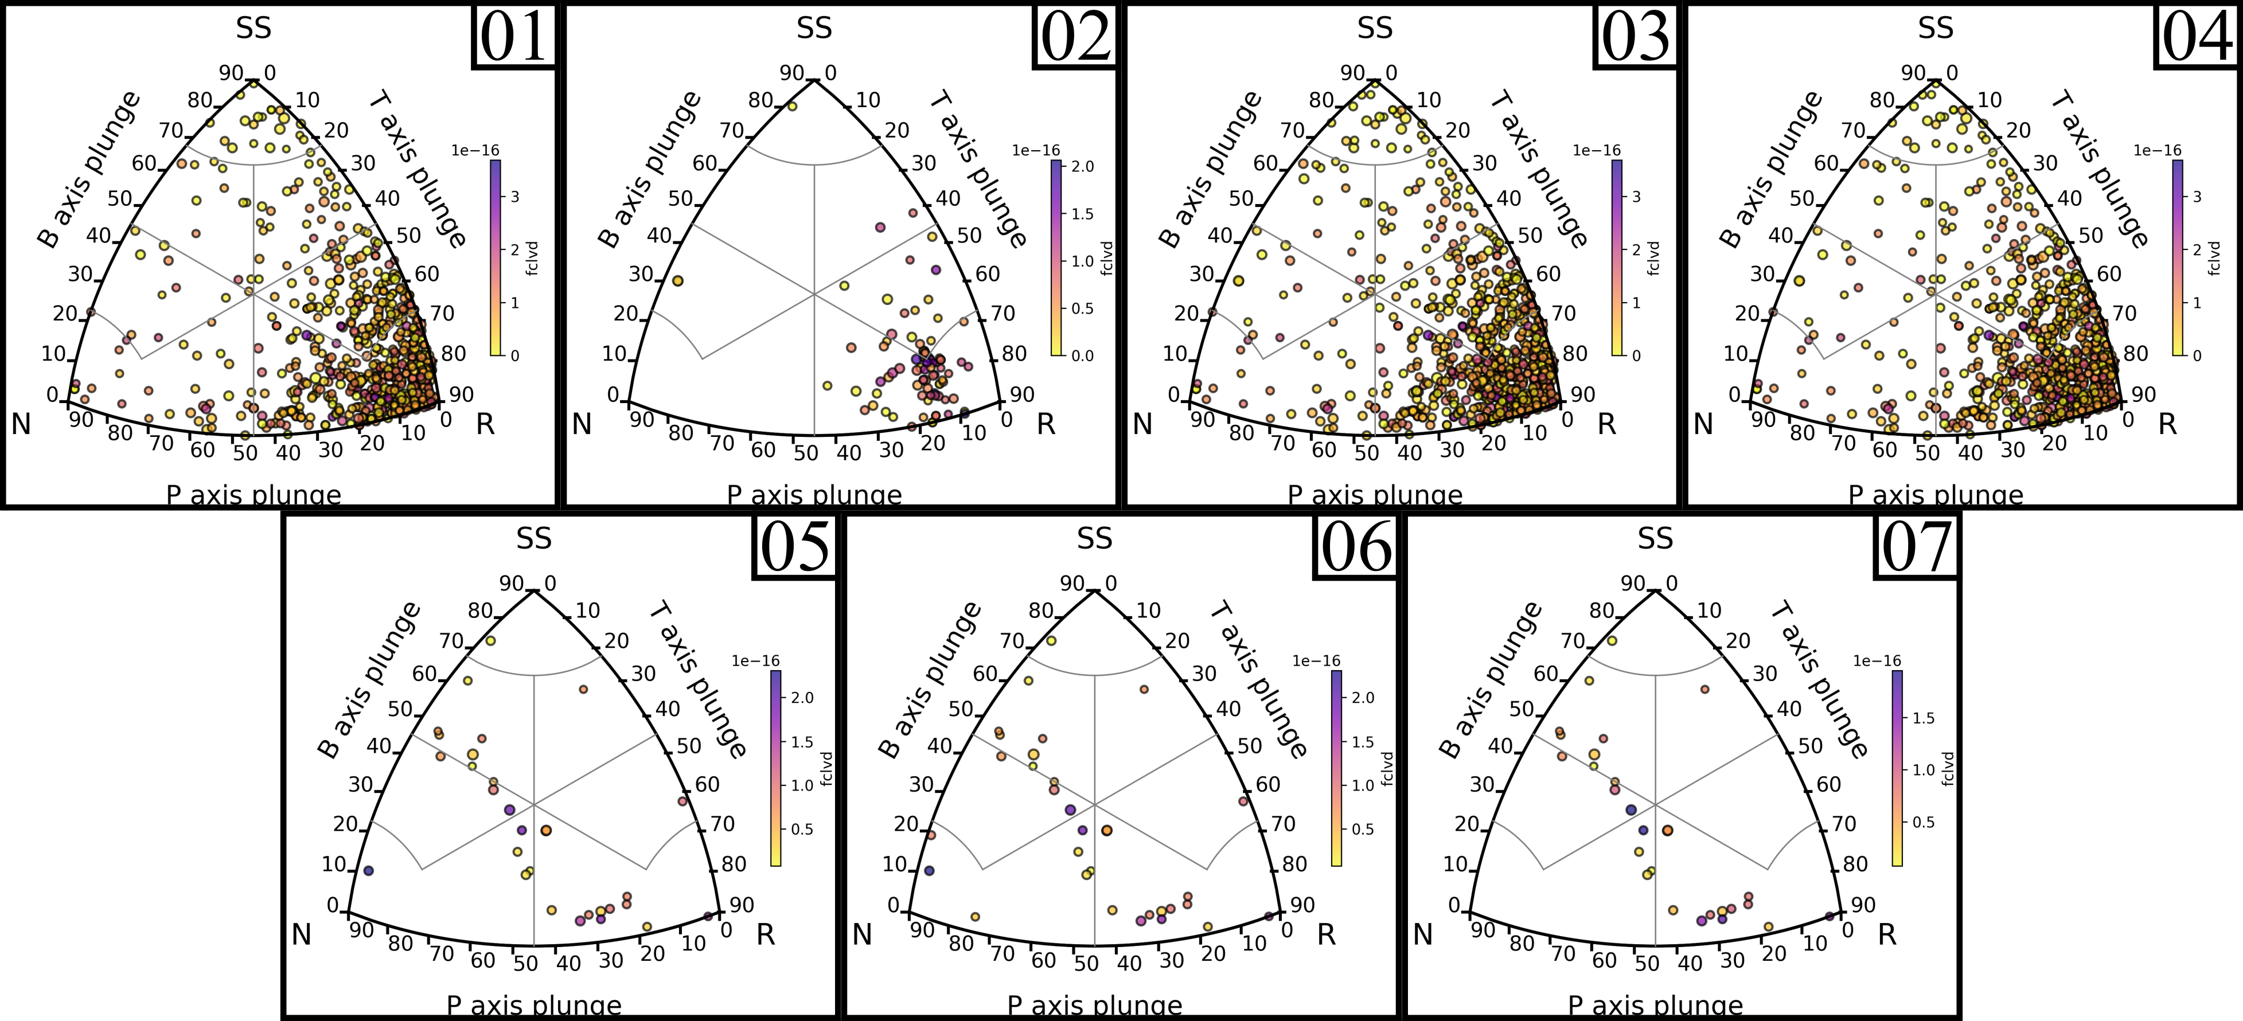
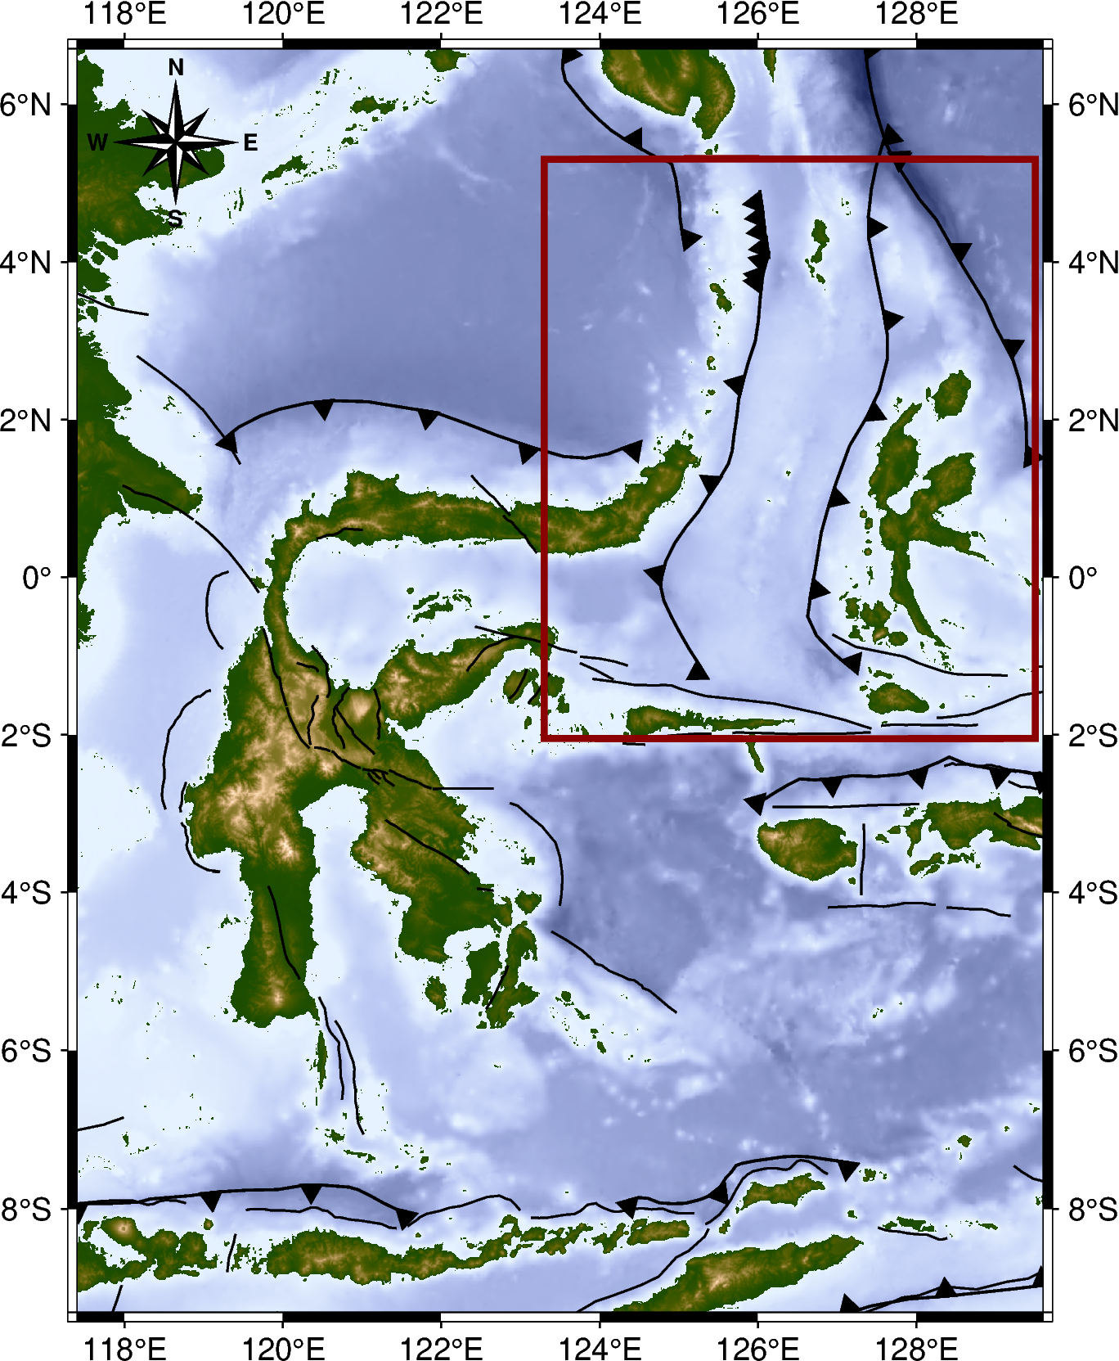
$$Clustering Result$$
Maluku Sea Area
3
1
4
2
5
6
7
In the Maluku Sea area, seven clusters were identified, consisting of two clusters with ε = 0.50, two clusters with ε = 0.40, and three clusters with ε = 0.35. These clusters divide the seismicity of the region into two main areas: the northern region that bends to the west and the southern region associated with the subduction zone.

Slide 9
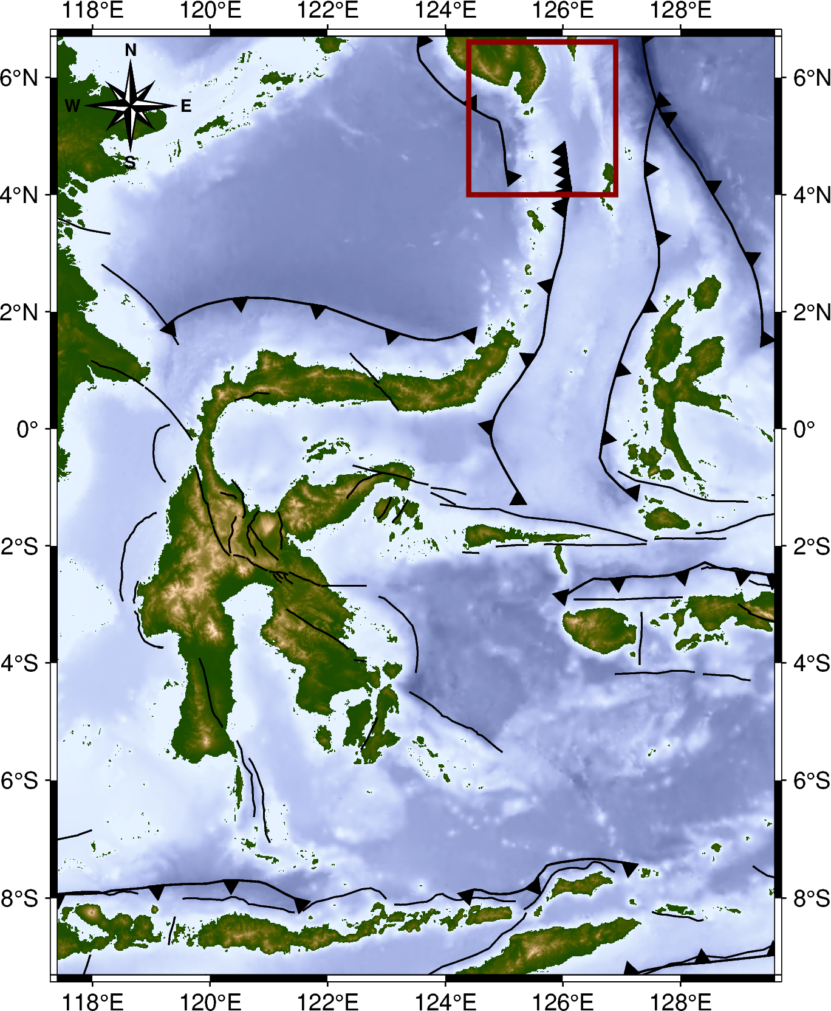
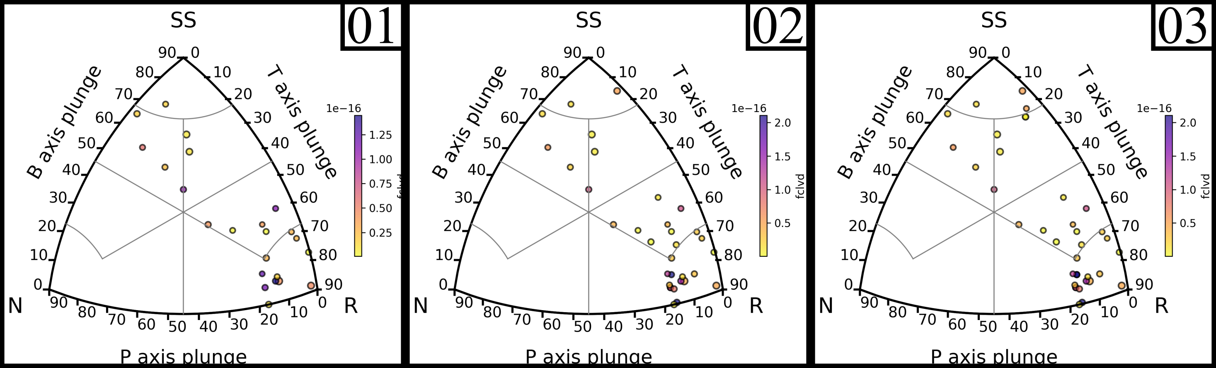
$$Clustering Result$$
Western Sangihe Area
01
02
In the Western Sangihe area, three clusters were identified, with one cluster for each epsilon parameter.
03

Slide 10
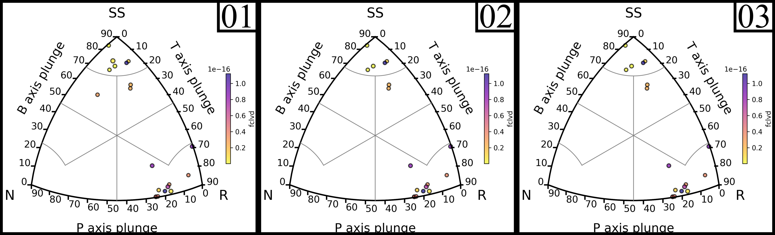
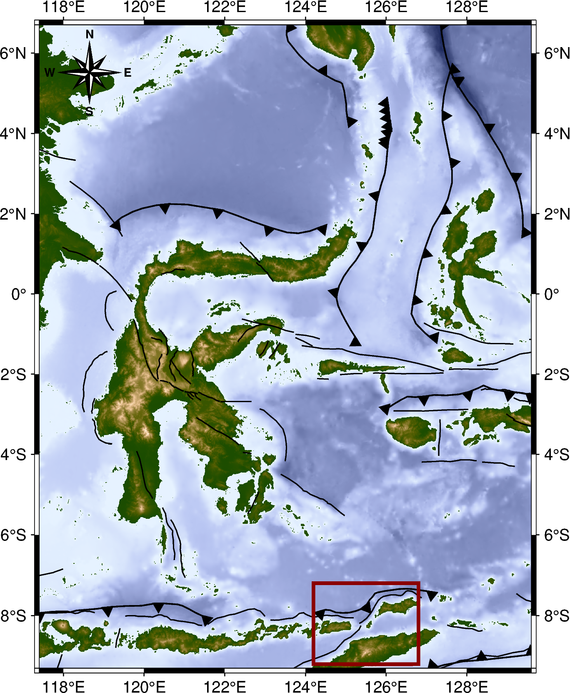
$$Clustering Result$$
Nusa Tenggara Timur Area
In the Nusa Tenggara Timur area, three clusters were identified, with one cluster for each epsilon parameter.
01
02
03

Slide 11
Stress Inversion Result
We calculated the main stress direction using the STRESSINVERSE program by Vavryčuk (2014), with confidence intervals determined through a bootstrap resampling method of 250 samples.
This calculation was performed for each cluster formed during the clustering process.
For each cluster, the SHmax value and Simpson index were calculated, providing an overview of the tectonic regime in the respective areas.

Slide 12
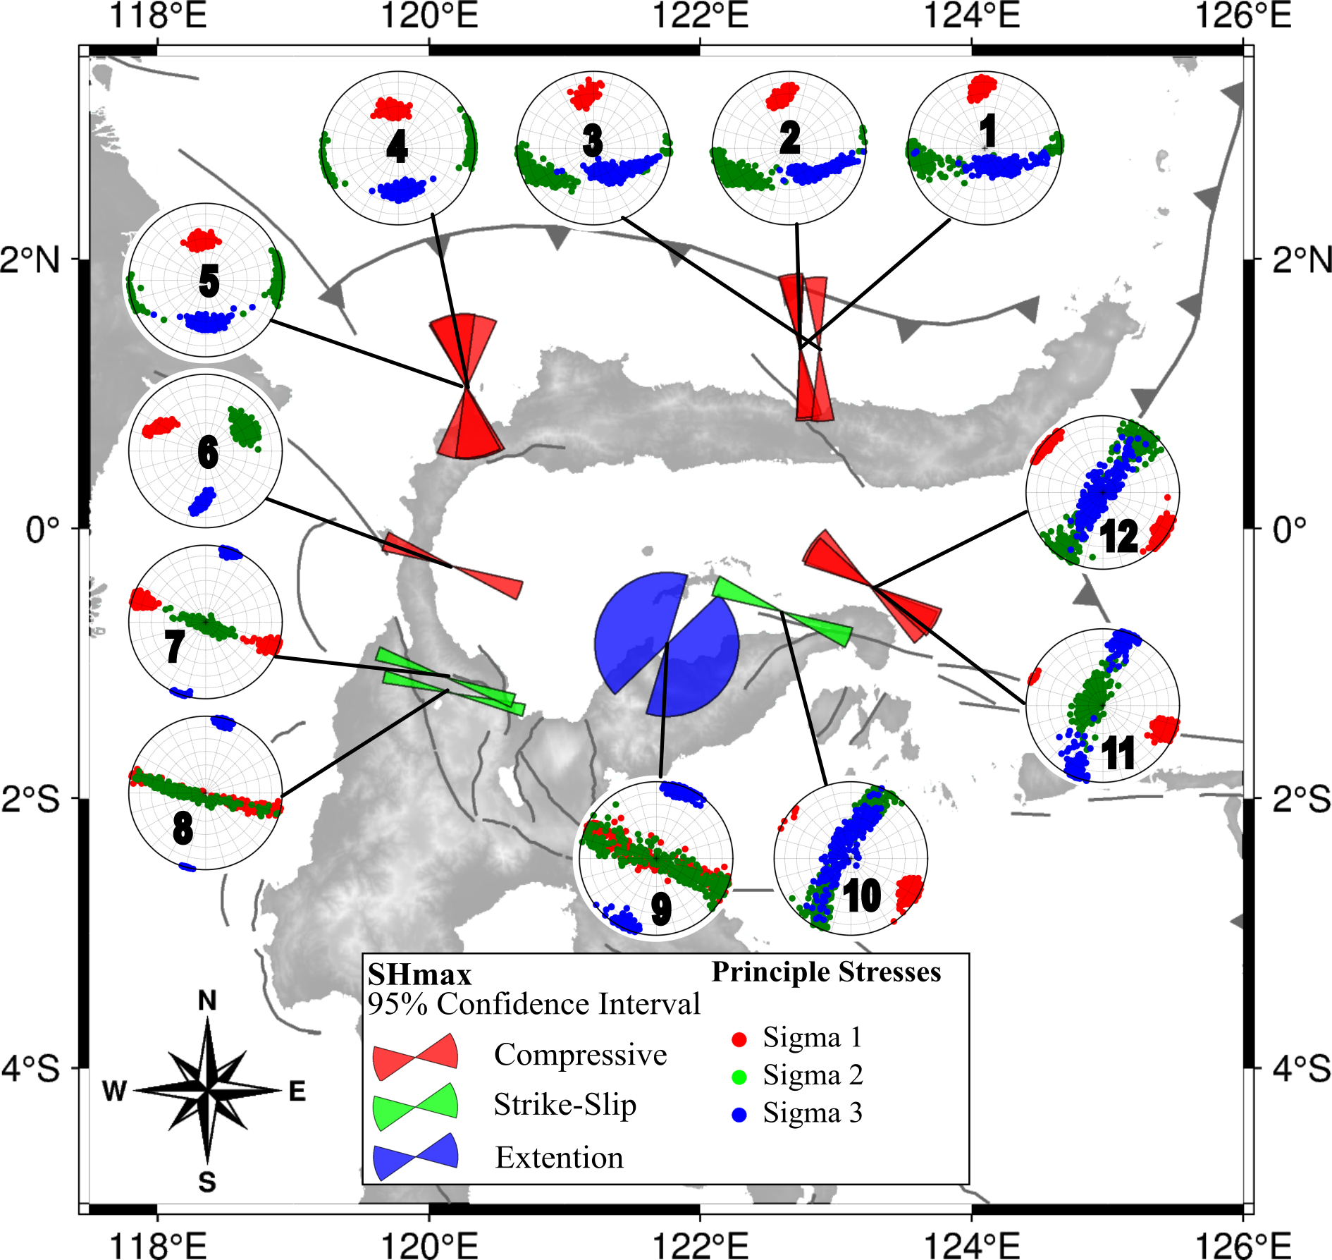
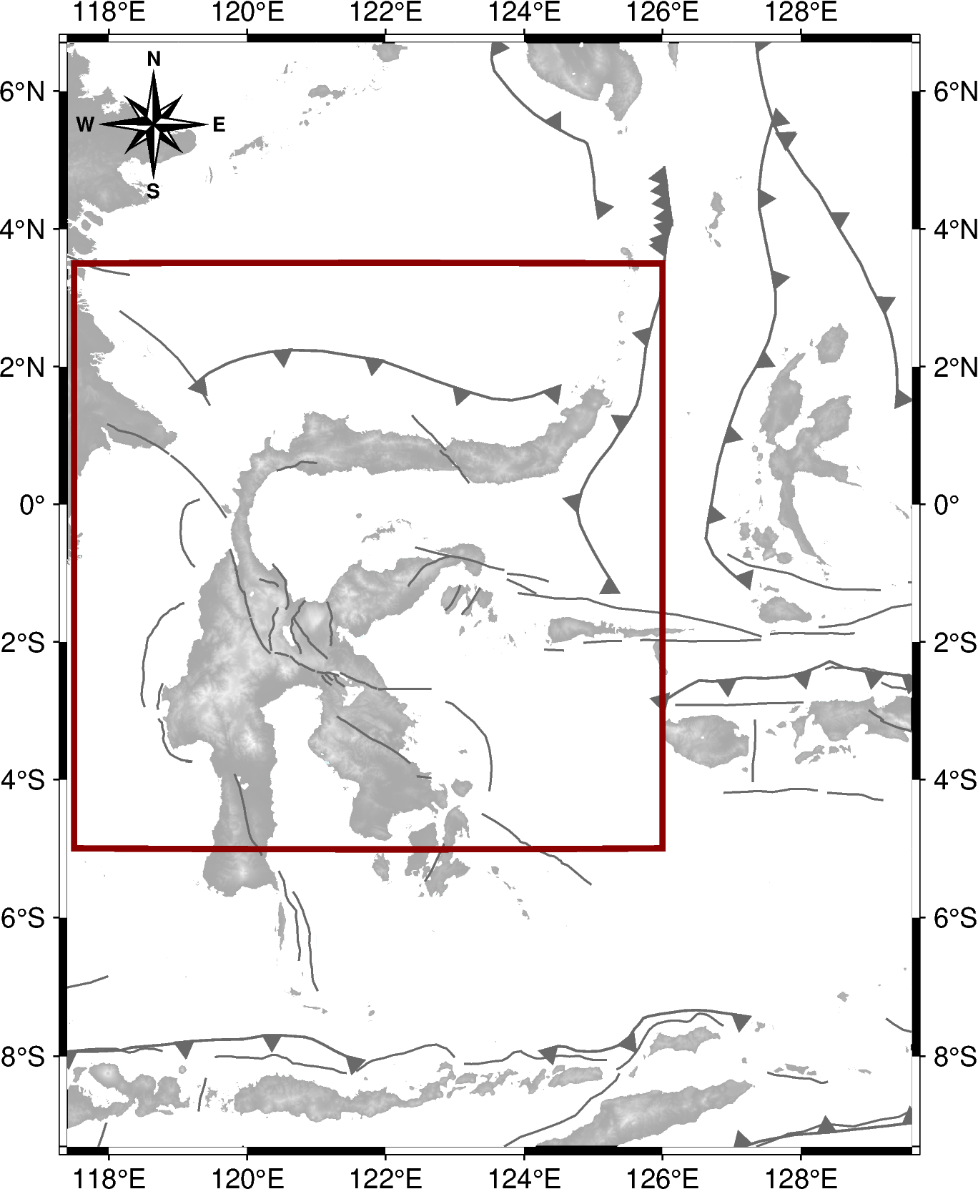
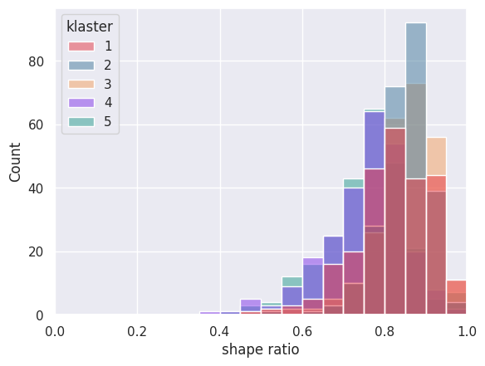
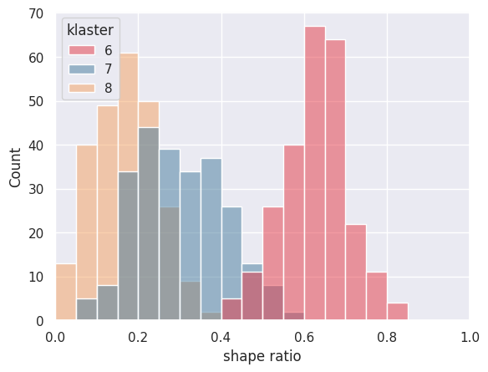
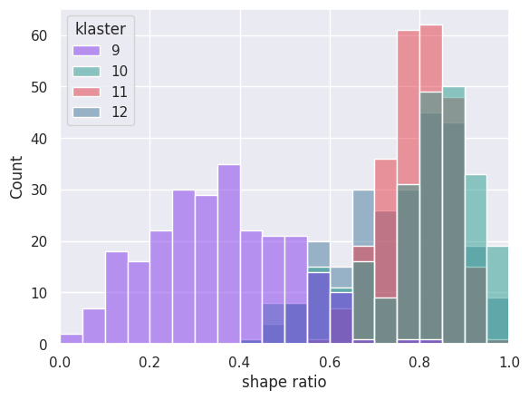
$$Stress Inversion Result$$
Northern Sulawesi
Cluster (event) | σ1 (˚) azimuth/plunge | σ2 (˚) azimuth/plunge | σ3 (˚) azimuth/plunge | R | SHmax | Aφ
Northern Sulawesi
1 (96) | 356/22 ± 09/11 | 255/29 ± 20/28 | 156/51 ± 58/27 | 0.786 ± 0.181 | 357 ± 09 | 2.13
2 (81) | 350/32 ± 11/10 | 241/23 ± 26/22 | 137/44 ± 37/22 | 0.826 ± 0.120 | 352 ± 10 | 2.14
3 (78) | 352/30 ± 11/11 | 245/23 ± 28/22 | 142/46 ± 42/24 | 0.795 ± 0.160 | 354 ± 09 | 2.14
4 (47) | 351/47 ± 16/08 | 083/05 ± 19/05 | 174/43 ± 22/08 | 0.705 ± 0.210 | 356 ± 28 | 2.23
5 (49) | 353/47 ± 14/08 | 265/07 ± 19/06 | 178/43 ± 22/07 | 0.745 ± 0.205 | 349 ± 18 | 2.23
6 (96) | 299/32 ± 10/11 | 059/41 ± 18/11 | 183/33 ± 07/10 | 0.617 ± 0.163 | 290 ± 08 | 2.37
7 (62) | 289/15 ± 06/15 | 121/74 ± 73/14 | 019/04 ± 05/04 | 0.308 ± 0.203 | 289 ± 06 | 1.72
8 (44) | 288/40 ± 09/38 | 106/47 ± 52/36 | 013/05 ± 05/05 | 0.177 ± 0.138 | 284 ± 05 | 1.89
9 (16) | 289/43 ± 50/41 | 123/44 ± 50/41 | 204/08 ± 15/08 | 0.365 ± 0.275 | 301 ± 75 | 0.98
10 (24) | 120/13 ± 11/12 | 206/35 ± 28/32 | 357/49 ± 74/33 | 0.731 ± 0.235 | 120 ± 12 | 2.10
11 (53) | 111/14 ± 08/13 | 283/64 ± 84/20 | 024/22 ± 14/22 | 0.788 ± 0.146 | 111 ± 08 | 1.17
12 (18) | 306/09 ± 15/09 | 215/29 ± 19/28 | 040/60 ± 70/27 | 0.744 ± 0.212 | 306 ± 16 | 2.14
In Northern Sulawesi, the inversion results reveal two dominant directions of SHmax with a wide range of tectonic regimes, including compression, strike-slip, and extension. The SHmax direction is predominantly oriented N-S in the northern arm of Sulawesi, while in the Central Sulawesi area, it is primarily oriented WNW-ESE.

Slide 13
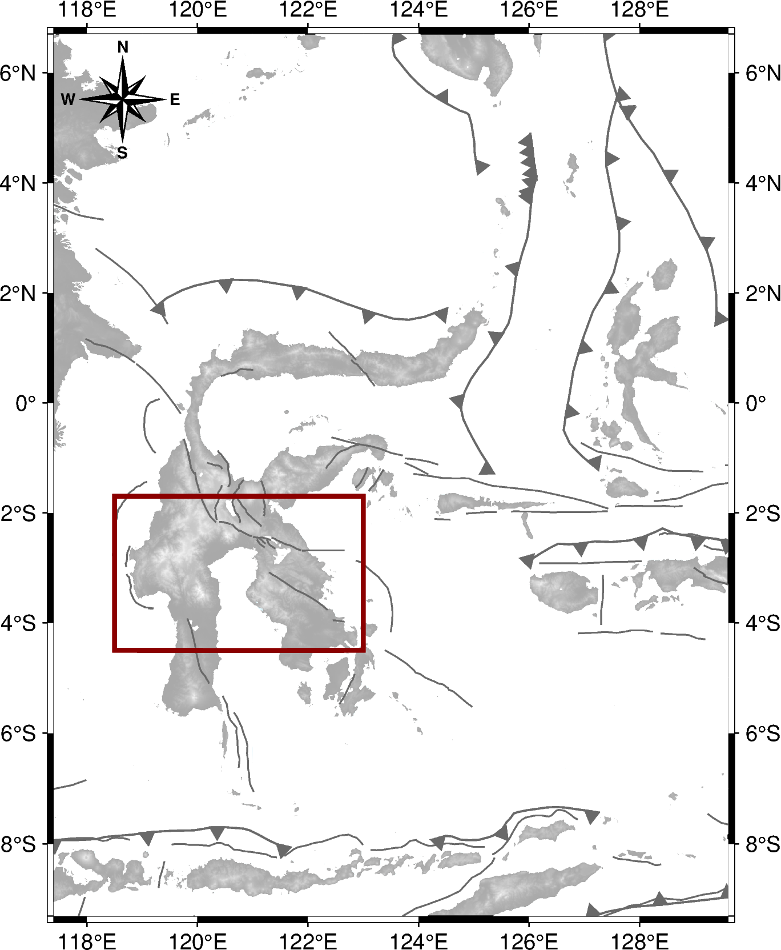
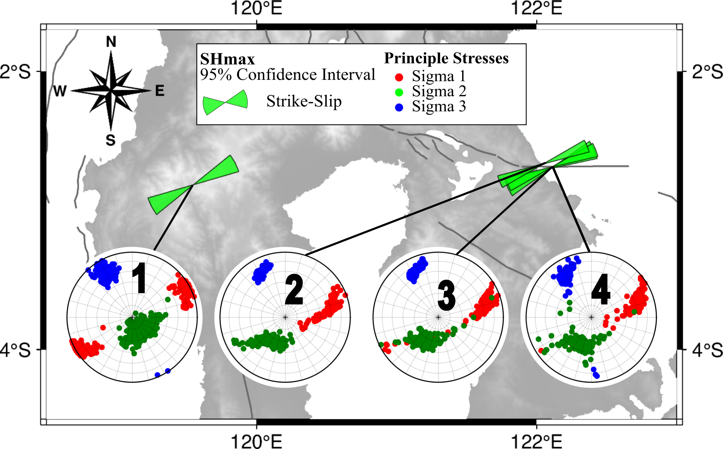
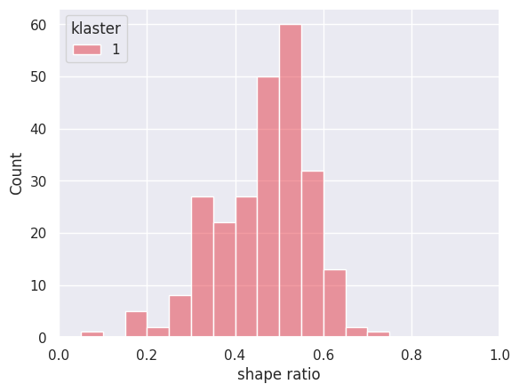
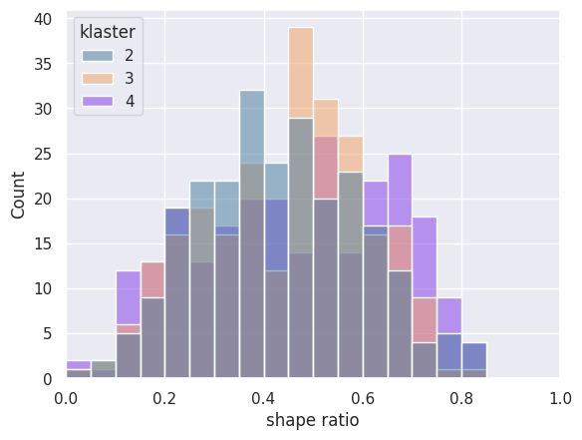
$$Stress Inversion Result$$
Southern Sulawesi
Cluster (event) | σ1 (˚) azimuth/plunge | σ2 (˚) azimuth/plunge | σ3 (˚) azimuth/plunge | R | SHmax | Aφ
Southern Sulawesi
1 (15) | 243/14 ± 15/14 | 146/67 ± 62/15 | 329/18 ± 10/15 | 0.433 ± 0.193 | 242 ± 11 | 1.56
2 (22) | 081/37 ± 17/22 | 211/44 ± 25/18 | 333/23 ± 09/07 | 0.451 ± 0.309 | 068 ± 08 | 1.57
3 (19) | 074/26 ± 13/18 | 204/53 ± 36/13 | 335/21 ± 09/07 | 0.423 ± 0.296 | 068 ± 09 | 1.55
4 (18) | 072/29 ± 15/21 | 194/47 ± 41/15 | 330/24 ± 10/11 | 0.550 ± 0.316 | 066 ± 11 | 1.46
The SHmax orientation in the South Sulawesi region reveals a dominant WSW-ENE direction in the Matano Fault area and the Mamasa swarm, with both areas exhibiting the same tectonic regime, specifically strike-slip.

Slide 14
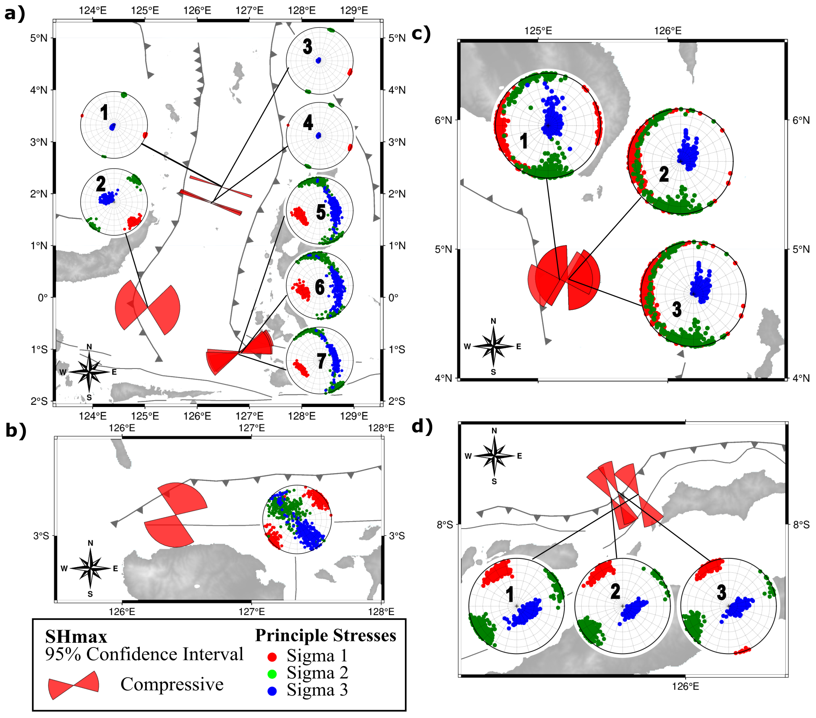
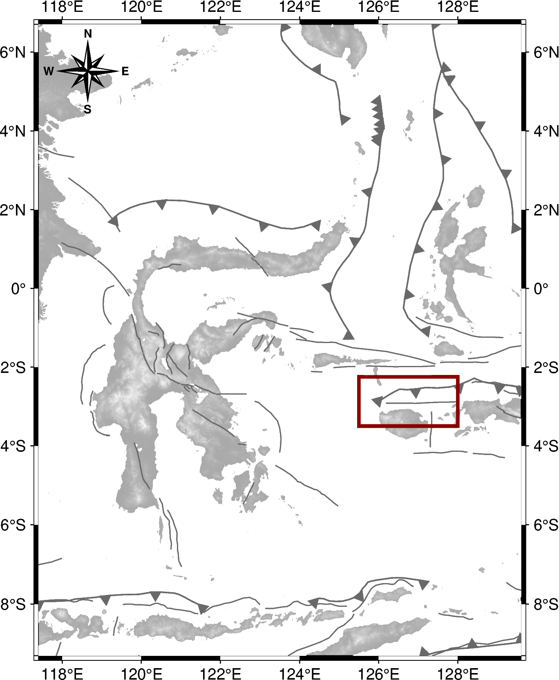
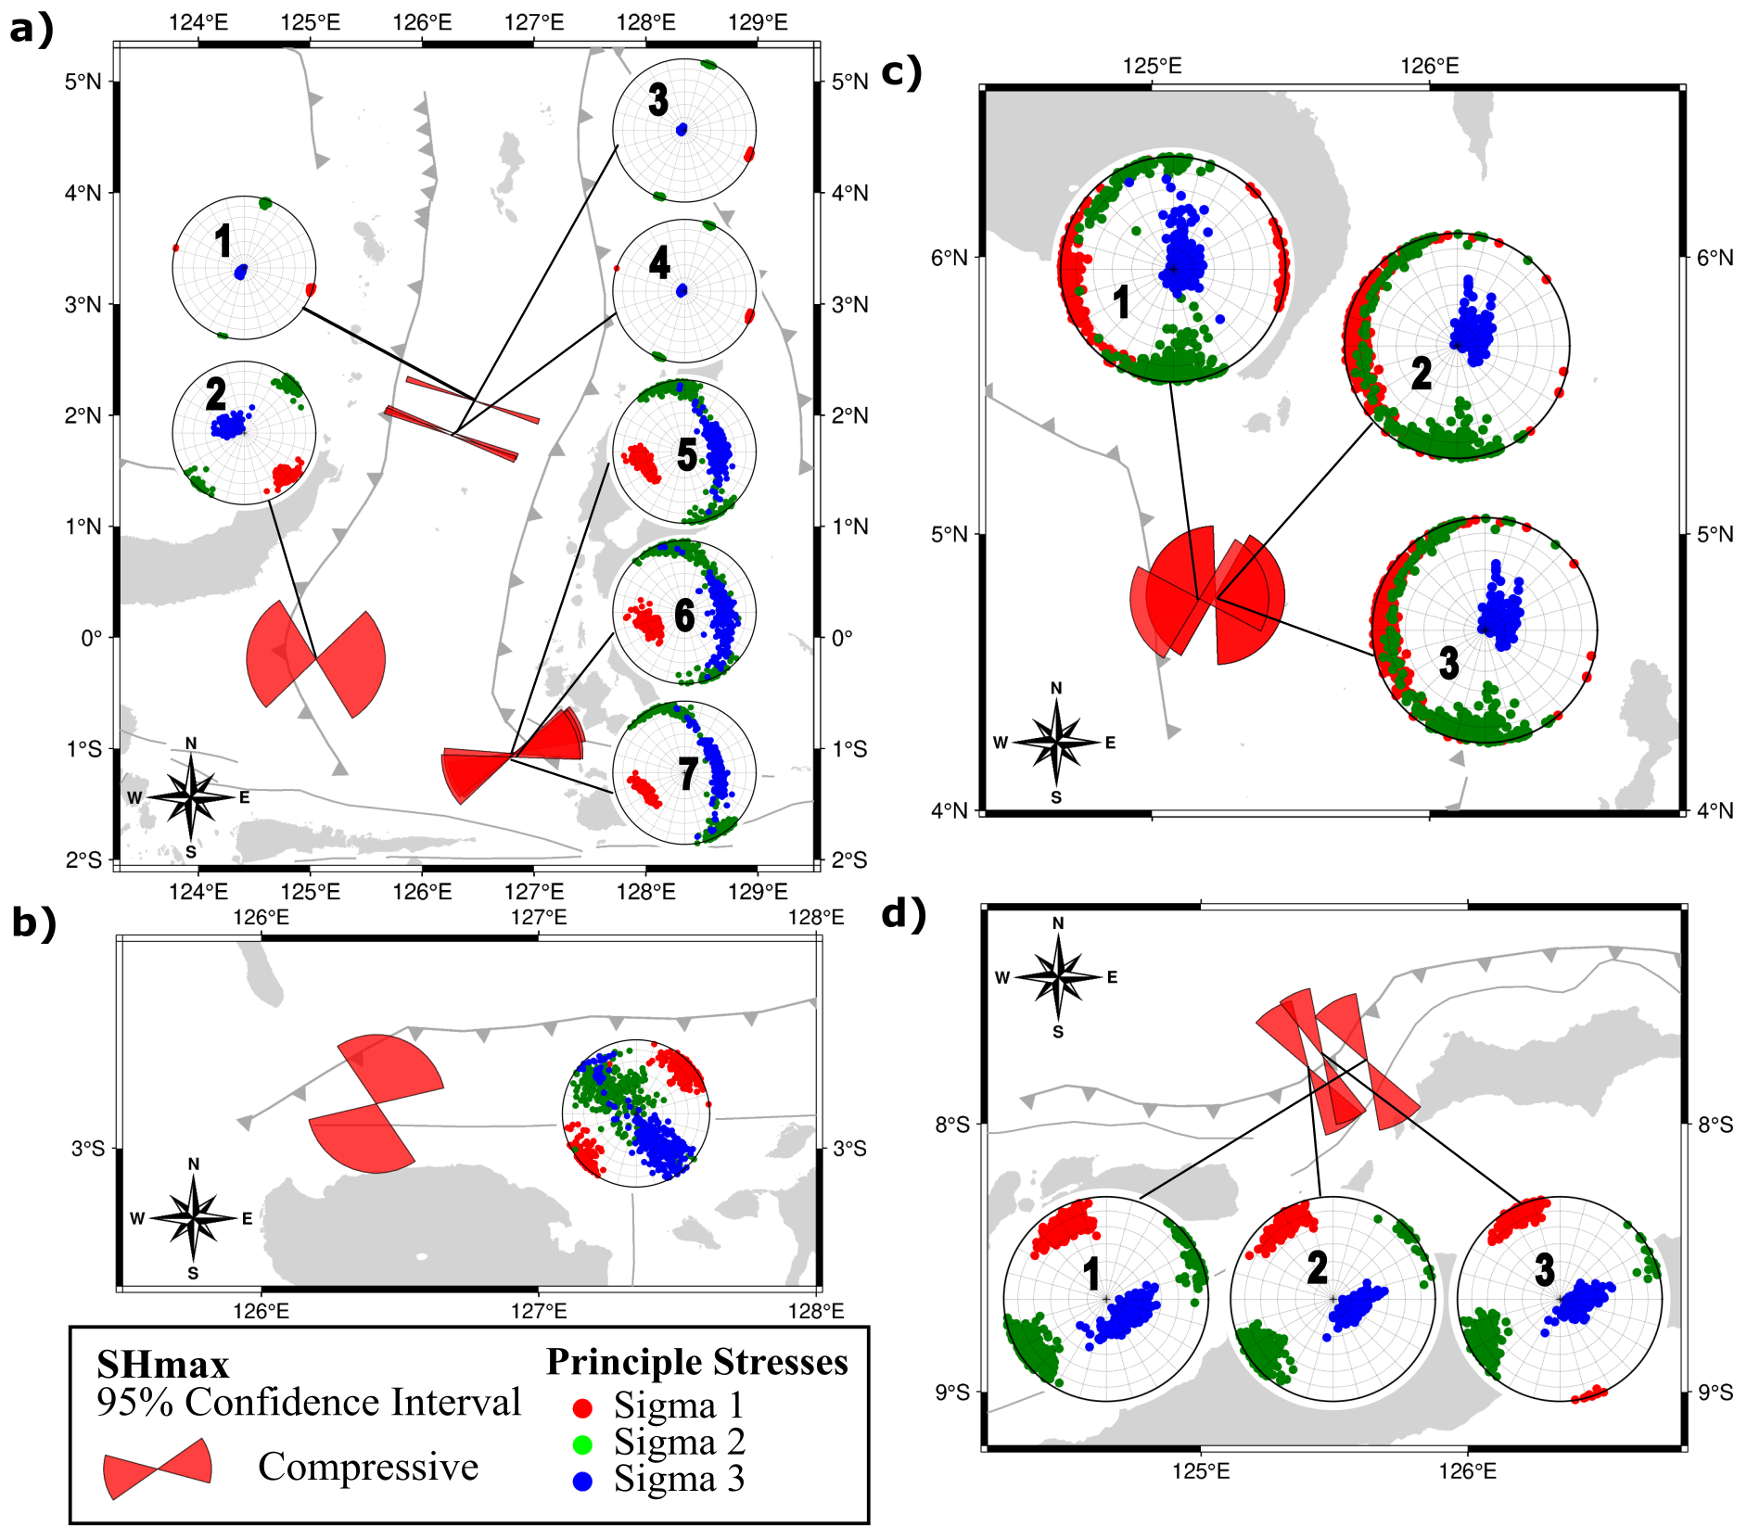
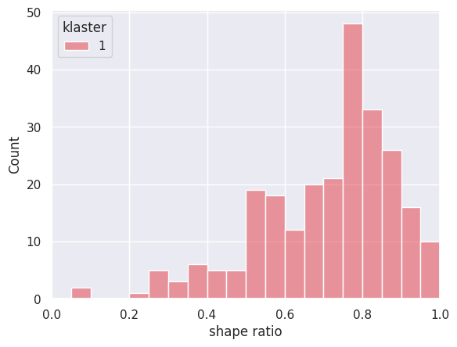
$$Stress Inversion Result$$
Wilayah Sula
Cluster (event) | σ1 (˚) azimuth/plunge | σ2 (˚) azimuth/plunge | σ3 (˚) azimuth/plunge | R | SHmax | Aφ
Sula Area
1 (18) | 047/16 ± 24/15 | 305/42 ± 69/36 | 149/41 ± 39/38 | 0.621 ± 0.339 | 021 ± 55 | 2.17
The Sula region displays a compressive tectonic regime with an NNE-SSW orientation of the SHmax.

Slide 15
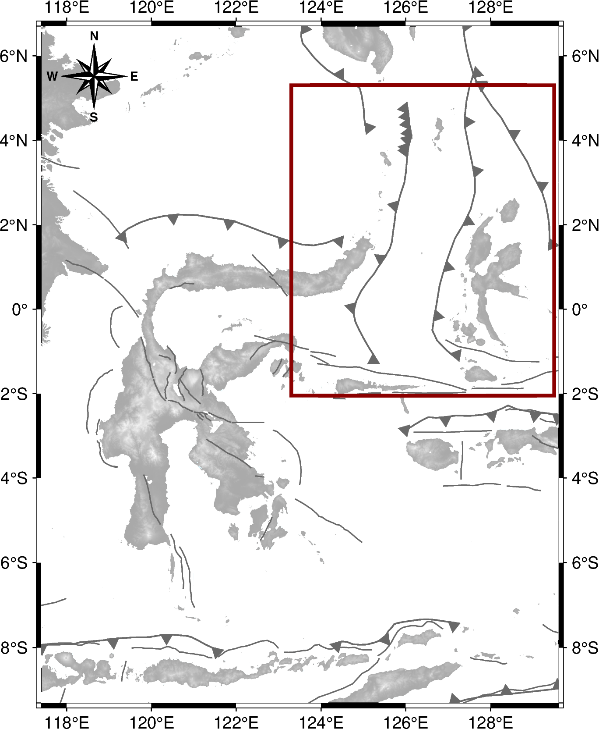
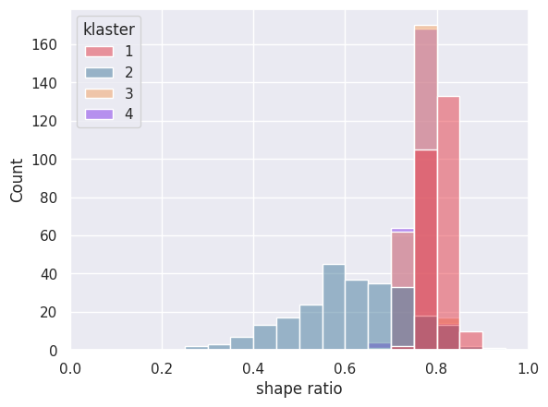
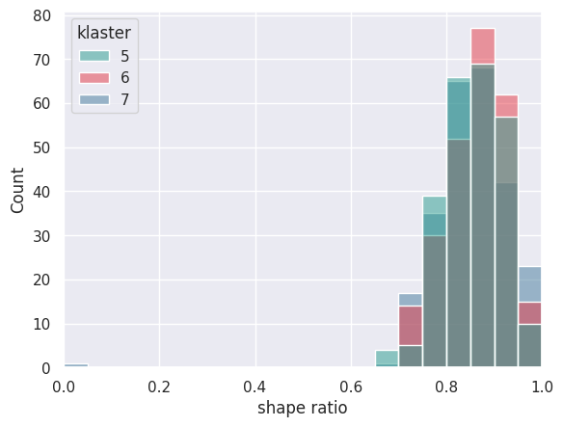
$$Stress Inversion Result$$
Wilayah Laut Maluku
Cluster (event) | σ1 (˚) azimuth/plunge | σ2 (˚) azimuth/plunge | σ3 (˚) azimuth/plunge | R | SHmax | Aφ
Maluku Sea Area
1 (638) | 108/03 ± 02/02 | 018/05 ± 02/04 | 230/84 ± 28/04 | 0.809 ± 0.046 | 108 ± 02 | 2.20
2 (93) | 135/17 ± 09/10 | 044/09 ± 10/09 | 300/70 ± 37/11 | 0.603 ± 0.234 | 097 ± 51 | 2.37
3 (749) | 111/04 ± 03/02 | 021/02 ± 03/02 | 291/86 ± 51/02 | 0.765 ± 0.046 | 111 ± 03 | 2.24
4 (742) | 110/03 ± 03/02 | 200/02 ± 03/02 | 291/86 ± 51/02 | 0.759 ± 0.047 | 110 ± 03 | 2.23
5 (30) | 249/38 ± 21/11 | 347/20 ± 30/20 | 082/45 ± 59/15 | 0.857 ± 0.120 | 253 ± 22 | 2.14
6 (32) | 251/44 ± 20/12 | 000/18 ± 44/18 | 095/34 ± 56/20 | 0.854 ± 0.116 | 249 ± 23 | 2.12
7 (28) | 244/37 ± 17/07 | 346/25 ± 35/25 | 072/39 ± 65/16 | 0.852 ± 0.116 | 245 ± 16 | 2.11
In the subduction zone, the North Maluku Sea area exhibits a compressive tectonic regime with a relatively diverse SHmax direction. The orientation ranges from WNW-ESE in the northern part, gradually rotating to WSW-ENE in the southern region.

Slide 16
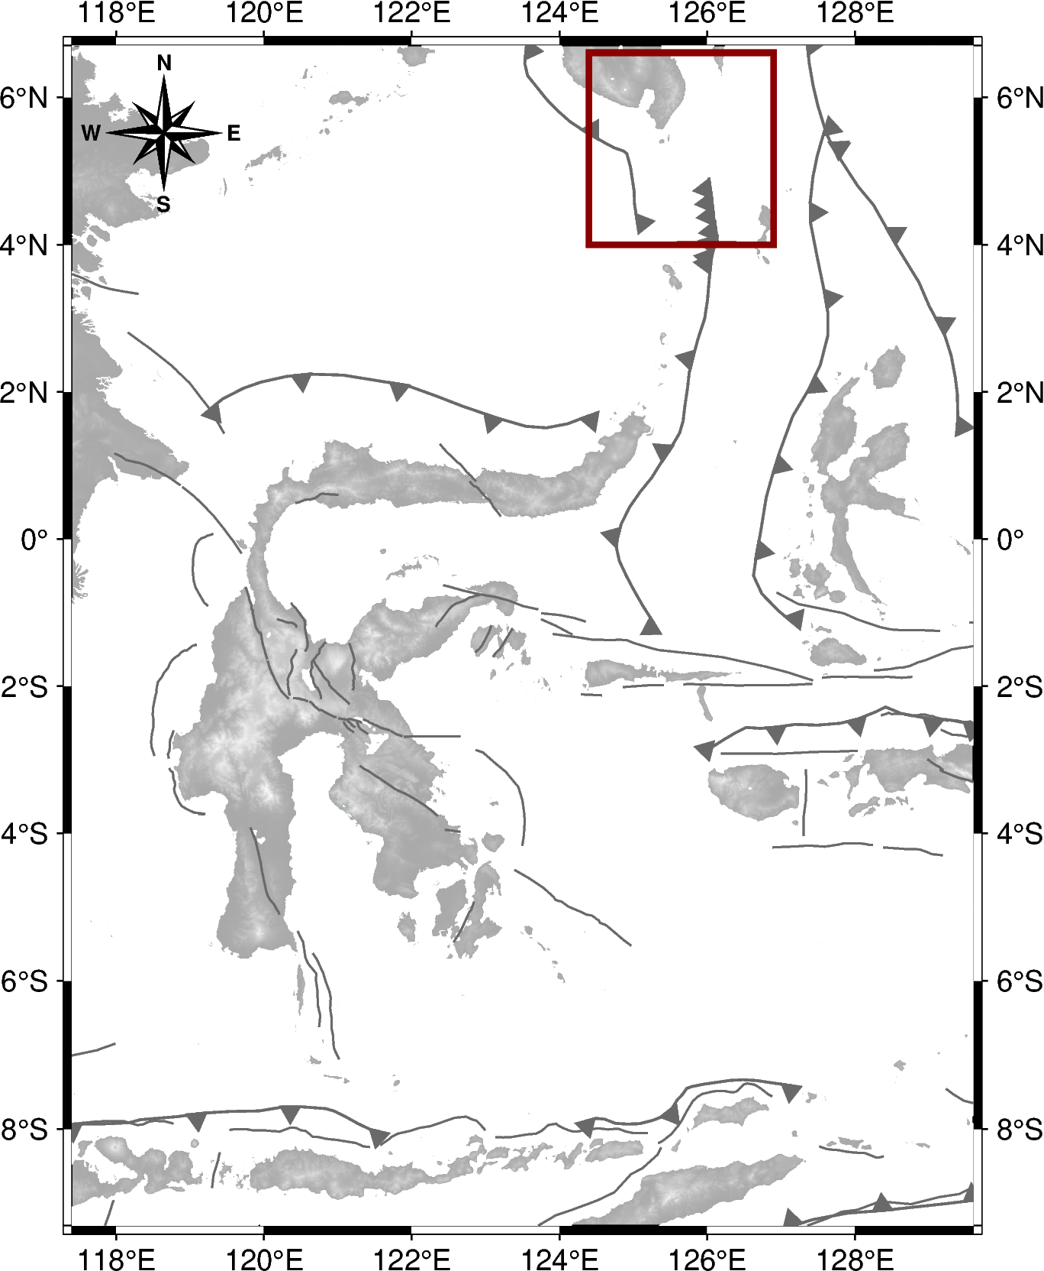
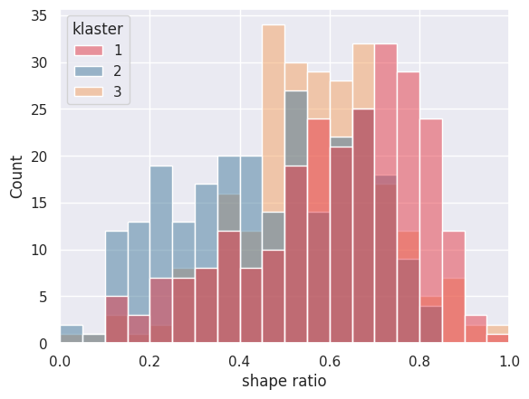
$$Stress Inversion Result$$
Wilayah Sangihe Barat
Cluster (event) | σ1 (˚) azimuth/plunge | σ2 (˚) azimuth/plunge | σ3 (˚) azimuth/plunge | R | SHmax | Aφ
Western Sangihe Area
1 (20) | 256/08 ± 42/08 | 166/23 ± 41/23 | 018/66 ± 81/22 | 0.526 ± 0.355 | 254 ± 43 | 2.41
2 (18) | 282/11 ± 73/10 | 193/16 ± 73/15 | 051/70 ± 55/16 | 0.442 ± 0.333 | 284 ± 74 | 2.68
3 (15) | 282/11 ± 73/10 | 193/16 ± 73/15 | 051/70 ± 55/16 | 0.442 ± 0.333 | 284 ± 74 | 2.68
The Western Sangihe region displays a W-E trending compressive tectonic regime.

Slide 17
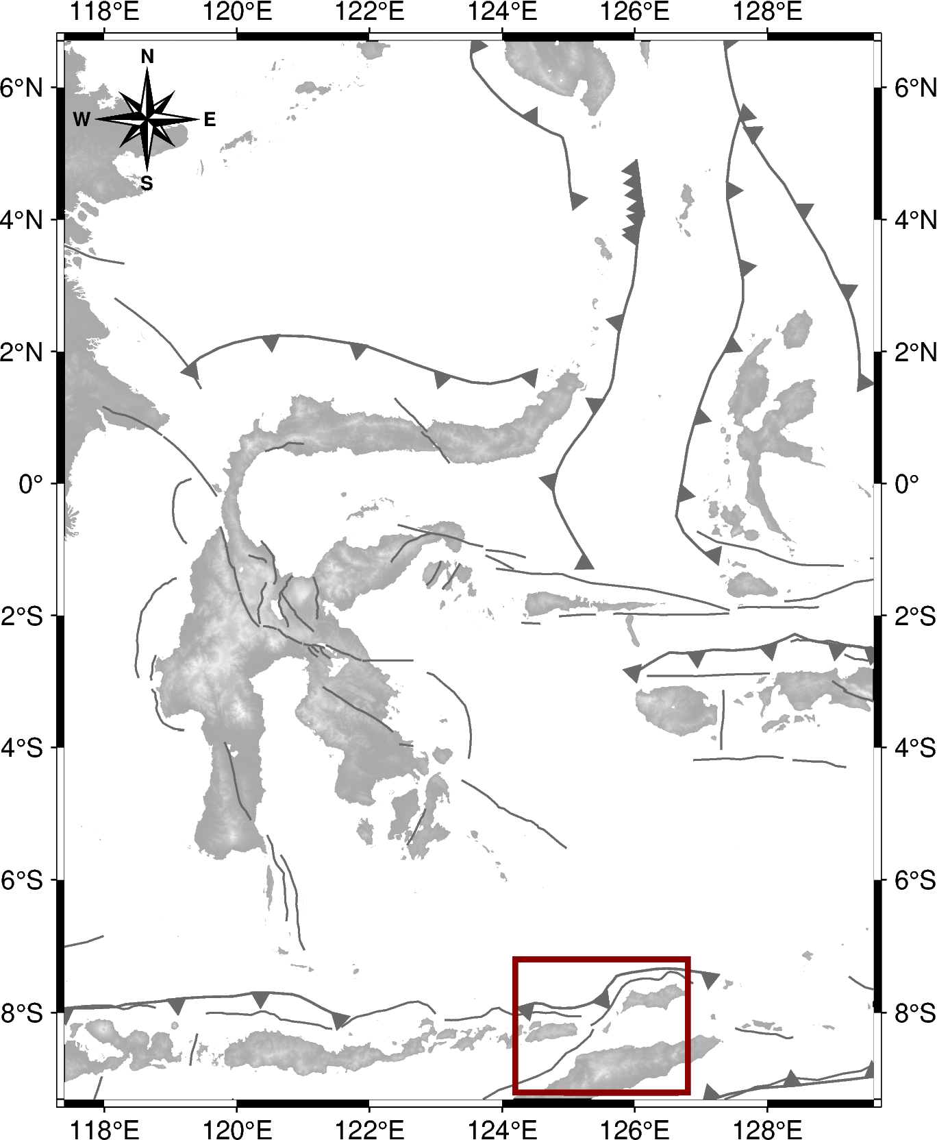
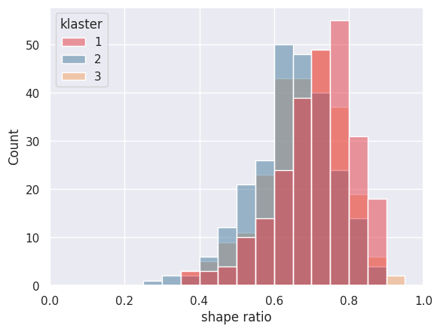
$$Stress Inversion Result$$
Wilayah Nusa Tenggara Timur
Cluster (event) | σ1 (˚) azimuth/plunge | σ2 (˚) azimuth/plunge | σ3 (˚) azimuth/plunge | R | SHmax | Aφ
Nusa Tenggara Timur Area
1 (23) | 329/18 ± 19/11 | 238/15 ± 20/14 | 136/66 ± 55/11 | 0.672 ± 0.203 | 330 ± 20 | 2.25
2 (33) | 326/14 ± 16/09 | 233/15 ± 17/15 | 122/67 ± 44/13 | 0.618 ± 0.211 | 328 ± 18 | 2.34
3 (37) | 333/09 ± 14/09 | 242/16 ± 15/15 | 101/70 ± 49/13 | 0.649 ± 0.210 | 335 ± 14 | 2.27
In the East Nusa Tenggara region, the main horizontal stress is oriented NNW-SSE, indicating a compressive tectonic regime.

Slide 18
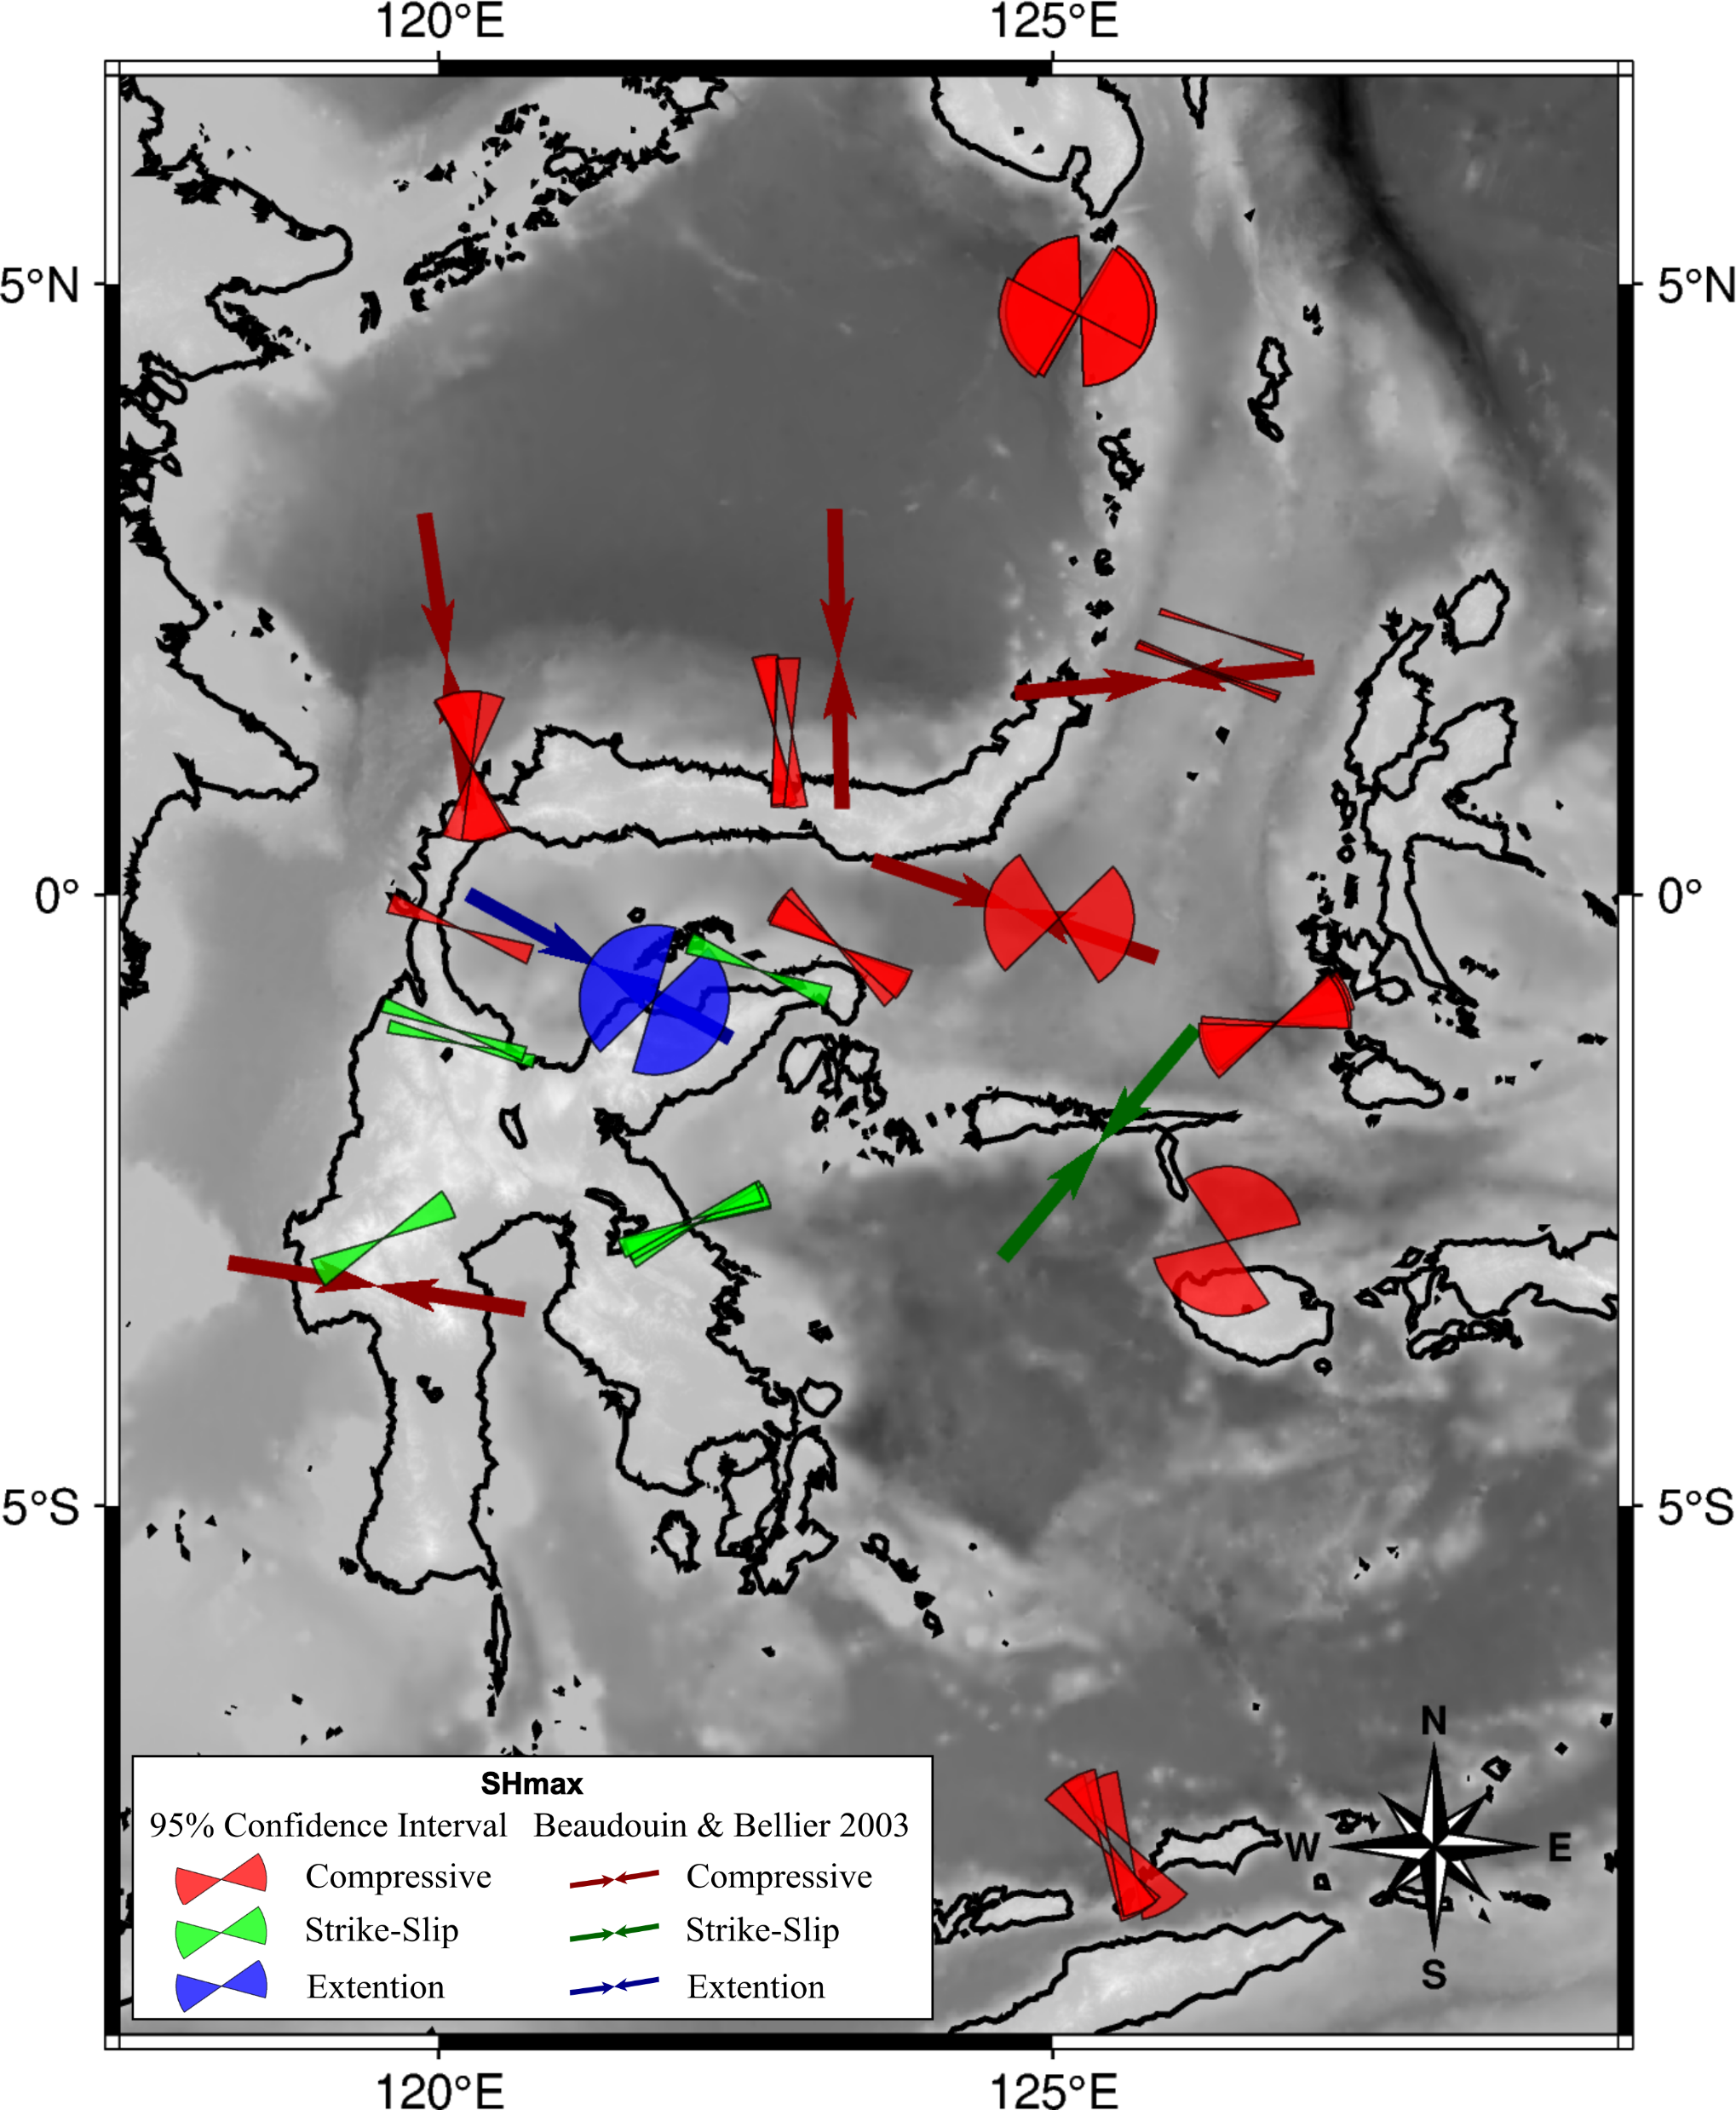
Comparing the calculated SHmax with the results of Beaudouin2003

Slide 19
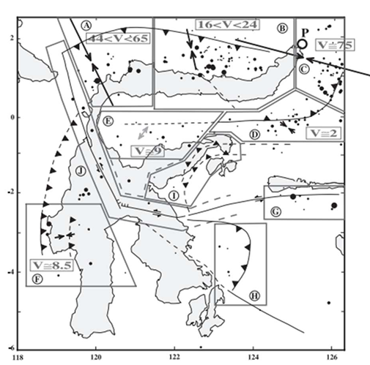
Comparing the calculated SHmax with the results of Beaudouin2003

Slide 20
Thank You
We look forward to your feedback

